Slide 1
STS across the Commonwealth
Lightning Talks
Session A

Slide 2
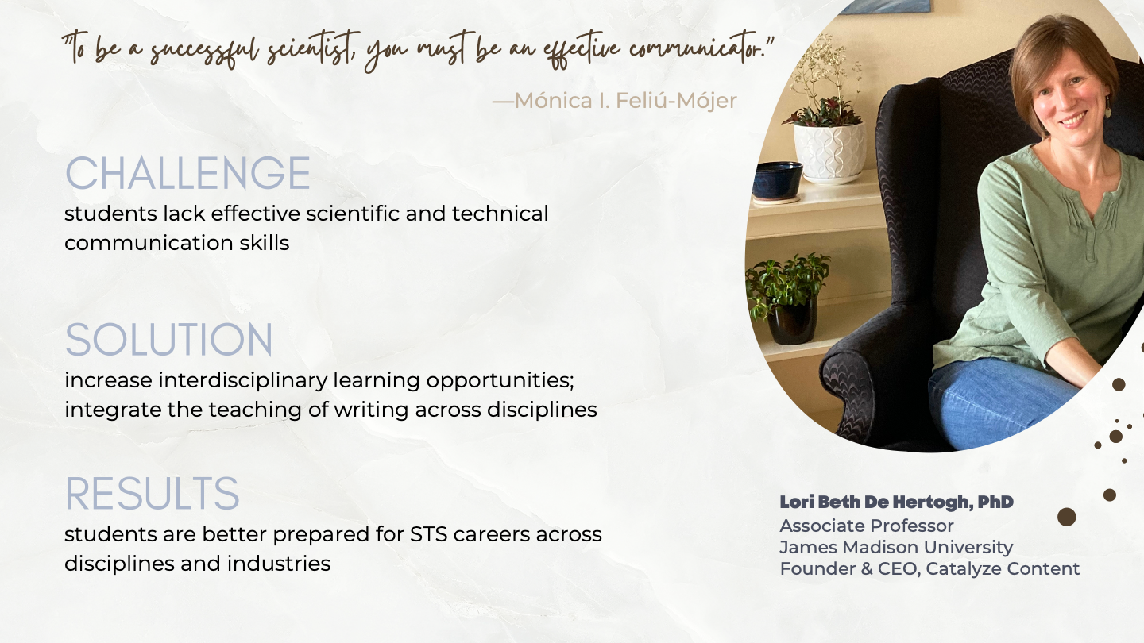

Slide 3
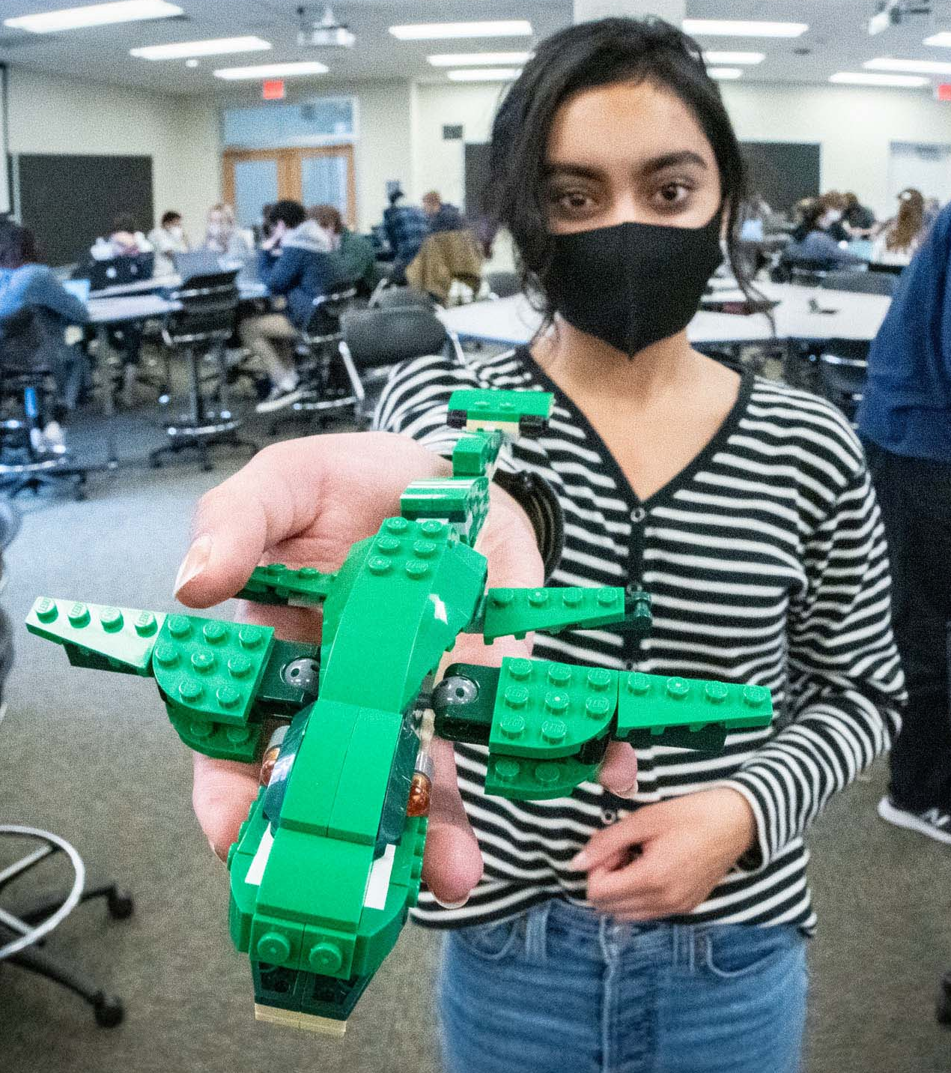
STS Across the Commonwealth
Ben Laugelli
University of Virginia
Seminar Topics
The LEGO® Course: Engineering Design and Values
Studio Projects
LEGO Brand Identity & History
Gendered Play: LEGO Friends
Open Innovation
Fan Culture
War & Violence in Play
Sustainability & Corporate Social Responsibility
Can studying the LEGO Group help students appreciate the important role STS and ethical perspectives play in engineering design?

Slide 4
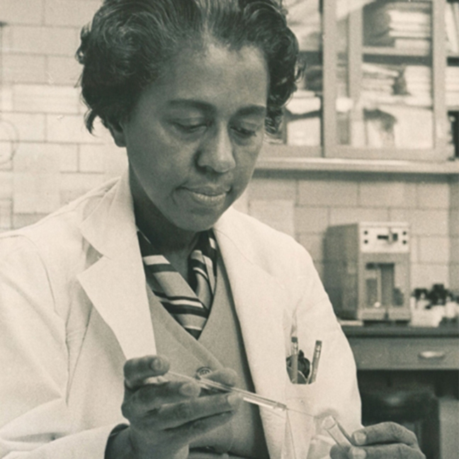
Women in STEM:
Has the environment in STEM workplaces changed after #METOO?
Prof Carolyn Byerly, Howard University and Prof Andrea Press, UVA
This Photo by Unknown Author is licensed under CC BY-NC-ND

Slide 5
Medicine and Minorities
Craig Konnoth, J.D., M.Phil
Professor of Law, University of Virginia
Greenwall Foundation Scholar
 | Race | Sex
Physical Empiricism (1870-1920)
Non-Biological Theories (1920-1970)
Neurology and Genetics (1970-today?)
Goal of Oppression | Stigma (cultural imperialism) | Coercion (Violence)
Control (powerlessness)
Exploitation
Exclusion (marginalization)

Slide 6
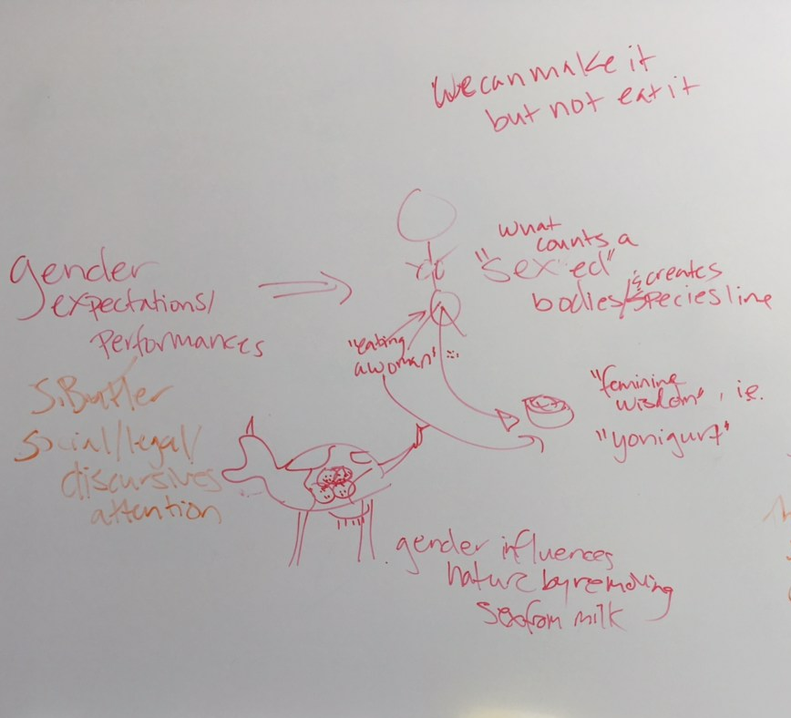

Rebecca Howes-Mischel & Megan Tracy
Sociology & Anthropology, James Madison University
Building a collaboration
Key Questions
Two anthropologists:
Medical Anthropologist of Reproductive Politics
Legal/Political Anthropologist of Dairy Science
Found a shared project in feminist STS
What are the ramifications of enrolling microbes into human ways of seeing and defining difference?
How is this enrollment capitalized on?
What do we make of projects aimed at harnessing the effects of microbes’ replicating, reproducing, responding potential?
Focus
Key Implications
We study the gendered aftereffects of microbiome science.
Specifically, the maternal microbiome and how its model of reproductive relations crosses the species line between human and bovine bodies
Analogues are easy to make; replicating the dynamism of microbial relations is not. In part because the dynamism baked in cultural constructs.

Slide 7
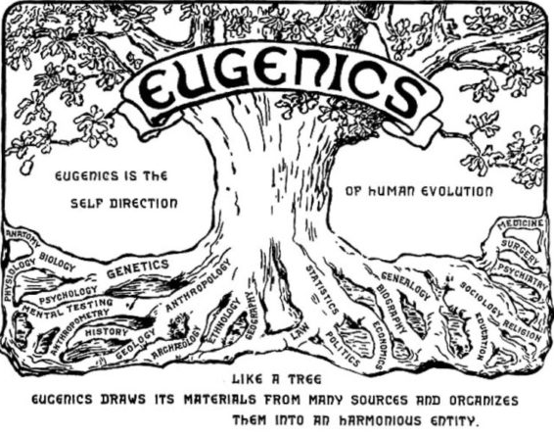


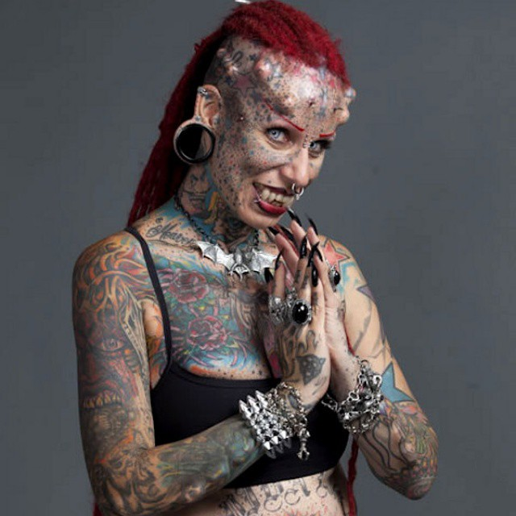
STS Across the Commonwealth
Joshua Earle
University of Virginia & Virginia Tech
Research Focus
Research Question(s)
Recent Finding
The technics, ethics, metaphysics, and politics of bodymind modification
What is Morphological Freedom?
What could it be?
Libertarian-flavored Transhumanism is eugenics dressed up is Apple Store Aesthetics.
Queer Transhumanism and Disability Communities show us a better way towards Morphological Freedom
Radical Intra-Dependence is how we get there.

Slide 8
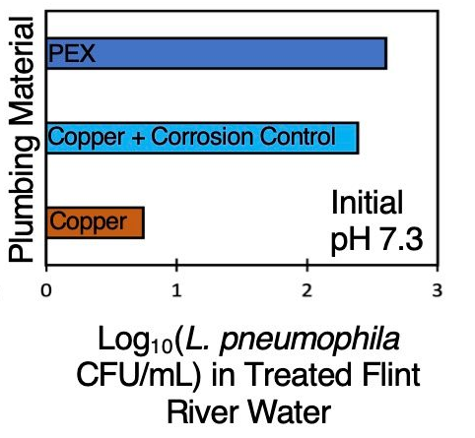
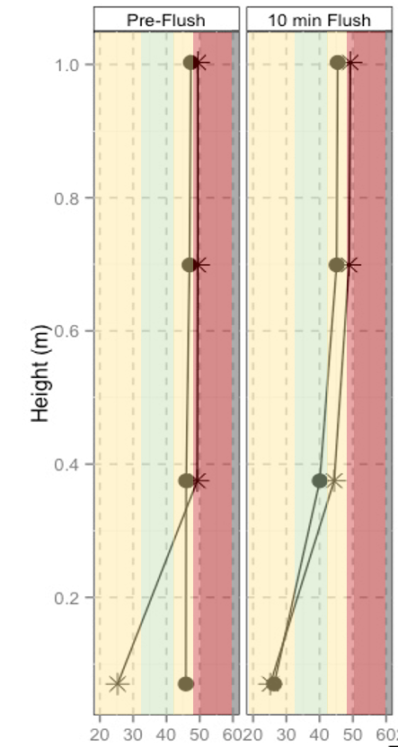

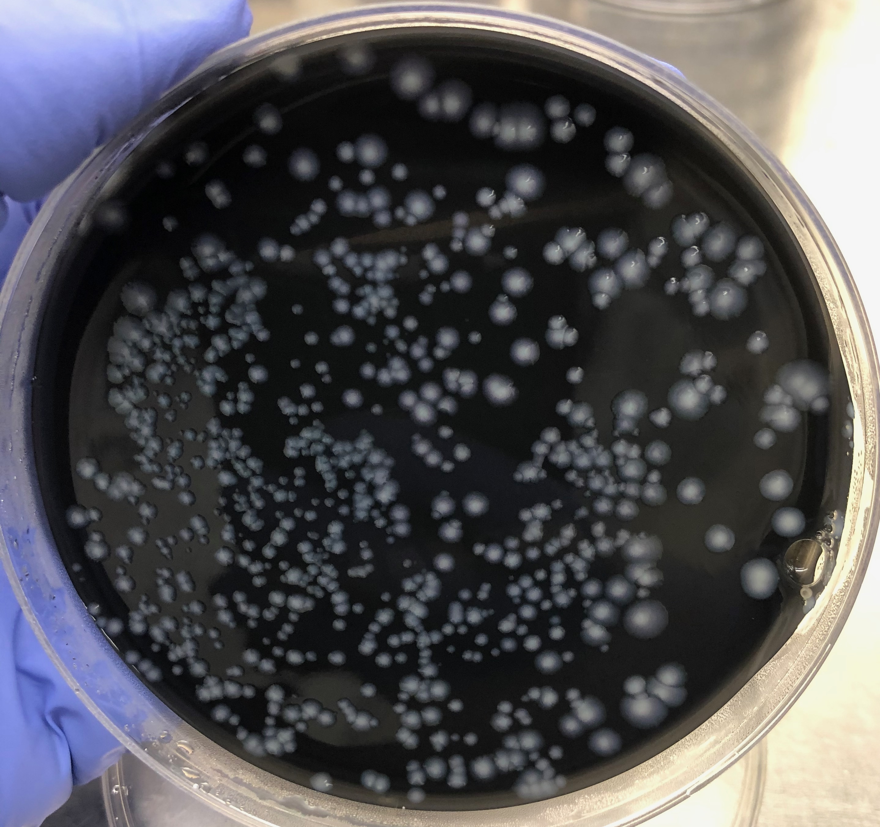
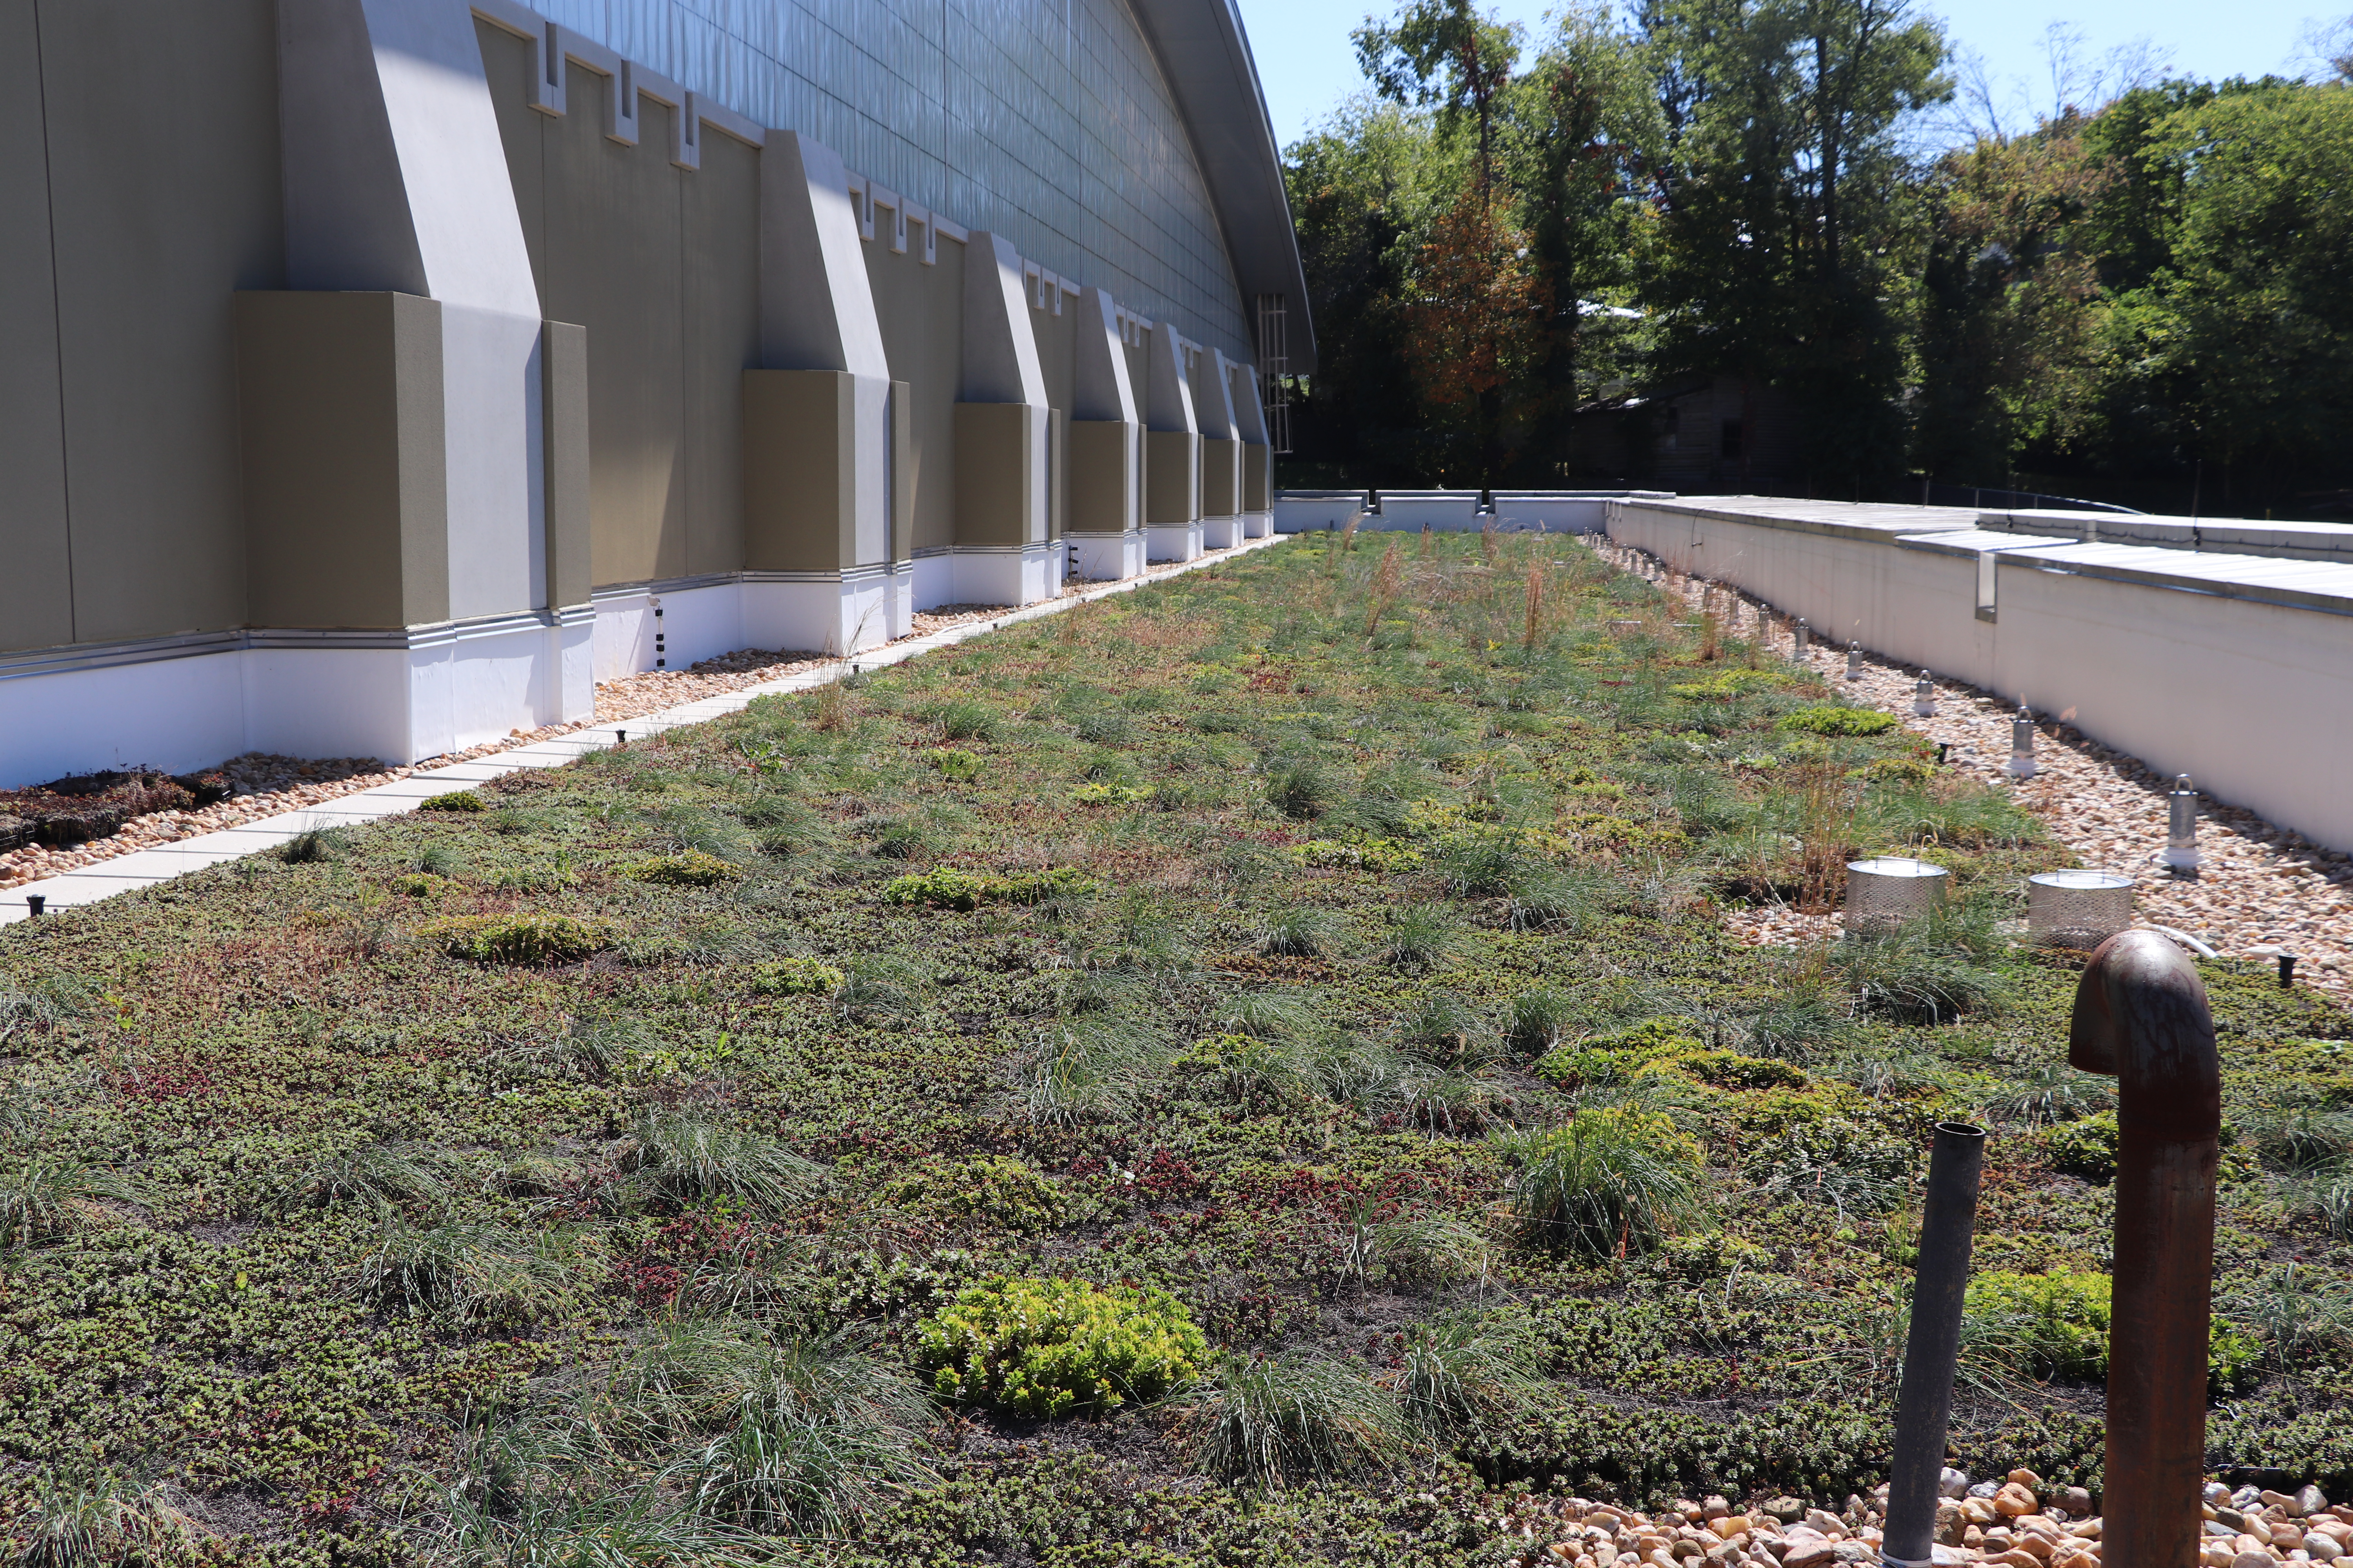
STS Across the Commonwealth
Rebekah L. martin
Virginia military Institute
Research Focus
Research Question(s)
Recent Finding
Water, Sustainability, and Public Health
How can humans interact with water more sustainably and protect their health?
How does low impact design change the water quality of distributed water? How can this be communicated to users?
Does more disease-causing bacteria grow in green buildings or traditional buildings?
Can we advise users to change their use based on building occupation patterns?
Water Quality
Water Quantity
Energy Use
Temp (Celsius)

Slide 9
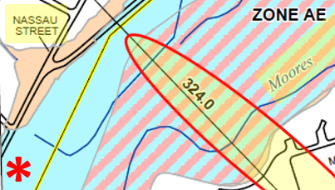
STS Across the Commonwealth
James Groves, PH.D., P.E.
University of virginia
Scholarship Focus
Scholarship Question(s)
Recent Finding
Highlighting environmental injustices likely to be perpetrated upon marginalized community members around the globe as climate change intensifies.
We hear about climate change and its impending impacts daily. My interest lies in telling personal stories of people and places on the front line of climate change impacts this century.
As the citizens of the wealthy, developed world indifferently saunter forward to address climate change, who will be hurt most cruelly and unapologetically?
Current focus: How will climate change impact my community and its people?
Ongoing interest: How will the demands of climate activists spur production of materials-intensive clean energy systems and turn selected global communities into sacrifice zones that must serve the unsustainable lifestyles of the global elite?
What should my community do when an unscrupulous property developer and engineer and a “hear no evil, see no evil, speak no evil” City Council set the stage for climate injustice, inviting low-and-moderate income community members to live in an increasingly risky flood plain?
A local developer-engineer acquired a significant financial interest in Charlottesville city property while leading the revision of the federal flood map that covered that property. Subsequently, the developer-engineer received approval (from an informed City Council) to “upzone” that property, setting the stage for more low-and-moderate income homes to be built in a designated federal flood plain.
There are currently no safe-guards to ensure that future residents are informed of the flood risks in this area of Charlottesville prior to signing their rental or home purchase contracts.

Slide 10
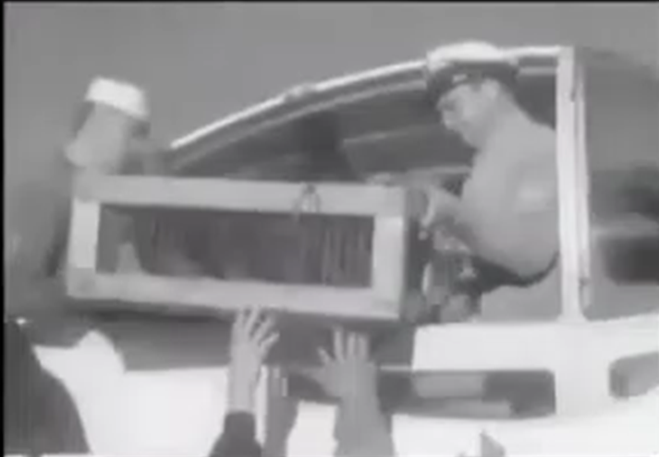
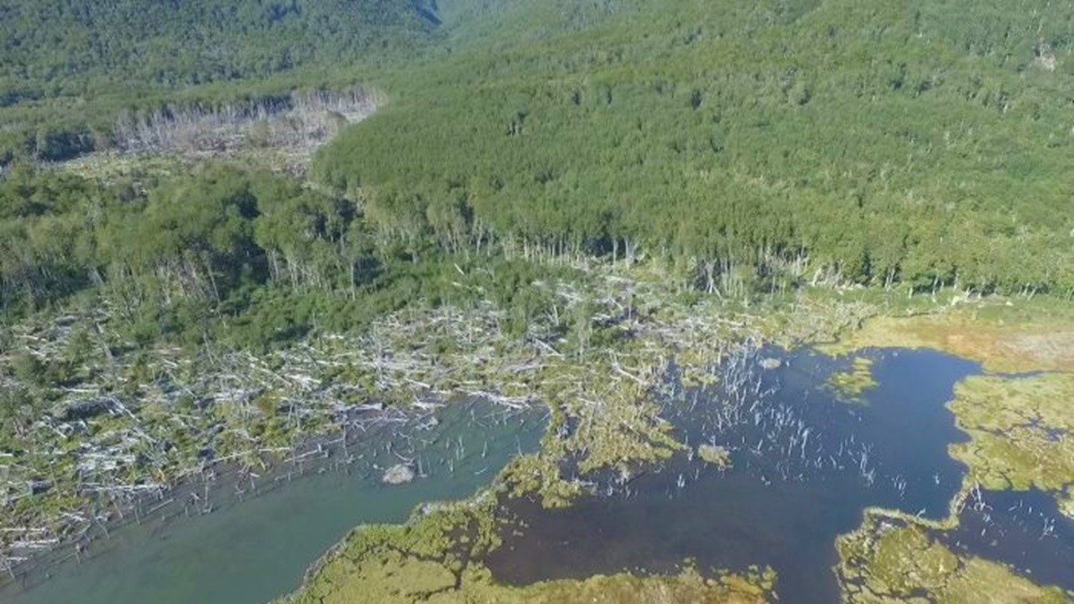
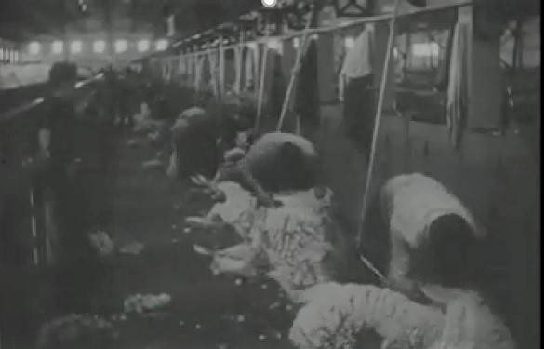
STS Across the Commonwealth
MARA DICENTA
William & mary
Race, Environmental Science & Reparation
Who, with whom, for what?
White Animals (2022)
Racializing Sheep & Beavers
White Argentina is more-than-human
Materialsemiotic Alliances
Tierra del Fuego (1940s-2020s)
Beavers, brought from Canada to whiten, modernize, & colonize, are today “invasive” - global eradication.
Racializing Environmental Knowledges
Ecological & Social Effects
Global Conservation and Reparation

Slide 11
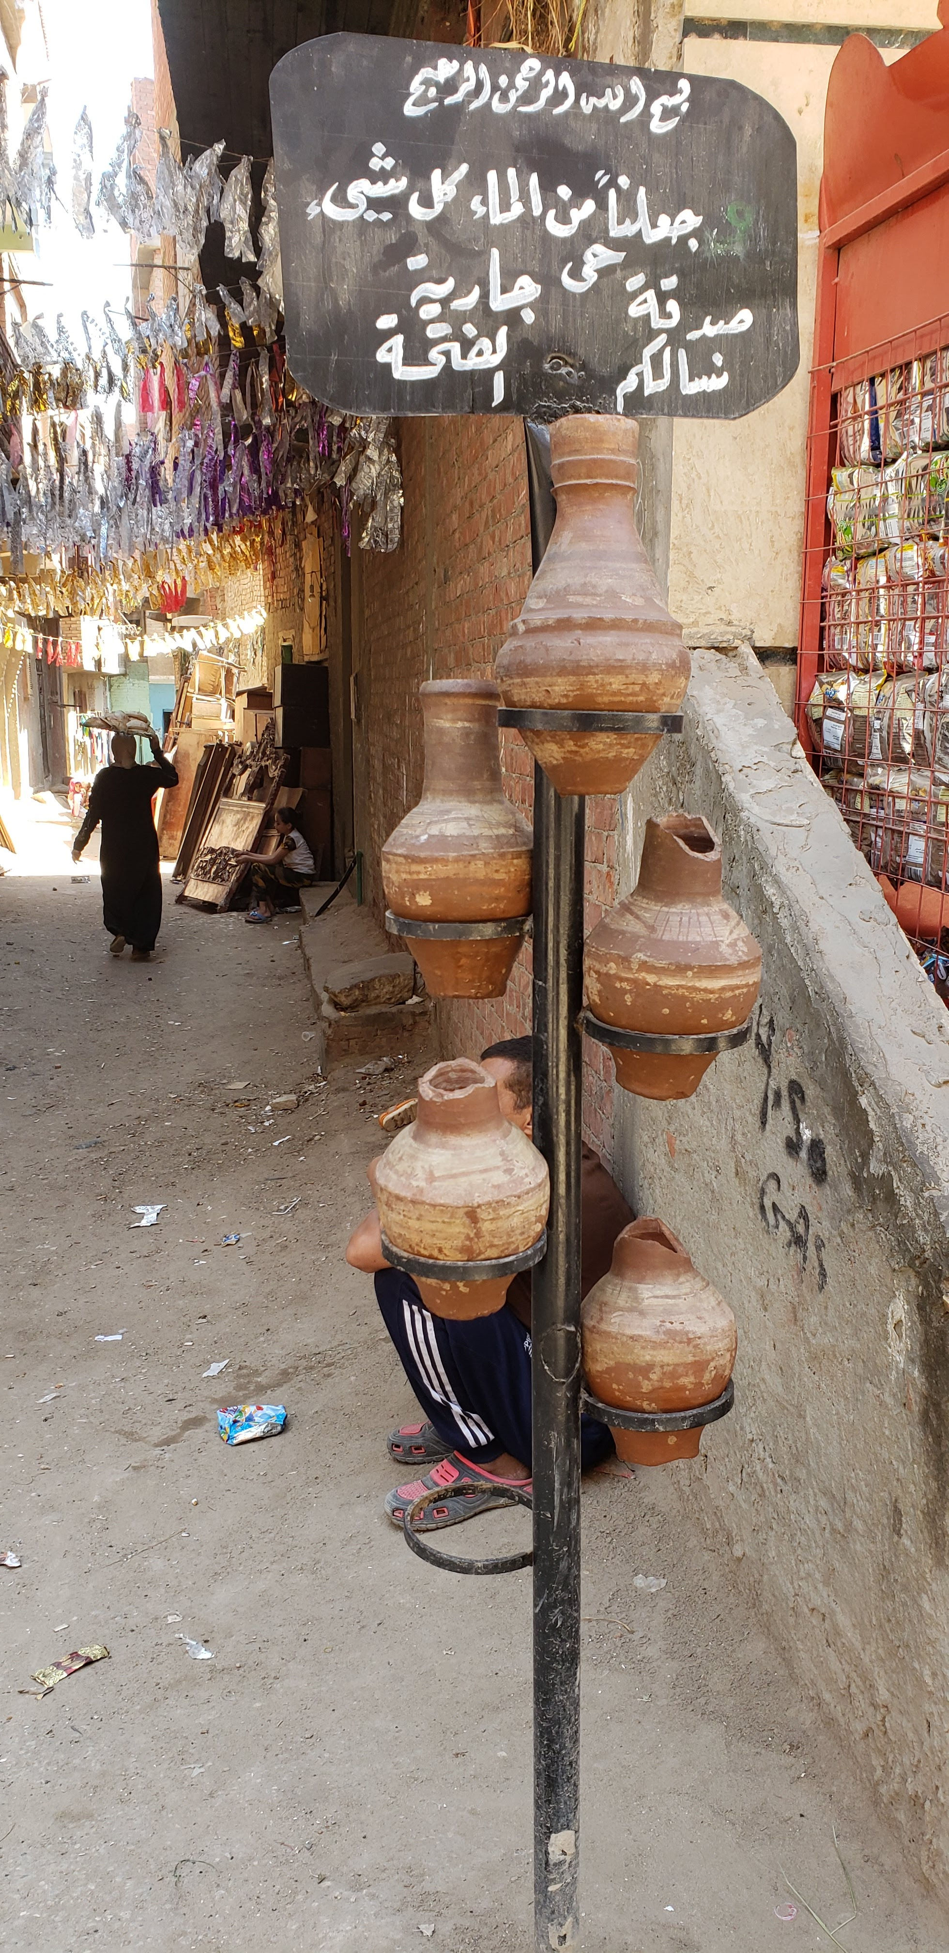
STS Across the Commonwealth
Tessa Farmer
MESALC and GLOBAL STUDIES
Research Question(s)
Recent Finding
Why do people create charitable water fountains in Cairo, Egypt?
What is the moral/political economy context that drives these practices?
How do these operate to change the context of water access?
How has this changed over time?
This is a long-standing practice that people are creatively reworking in the context of climate change-induced heat increases

Slide 12




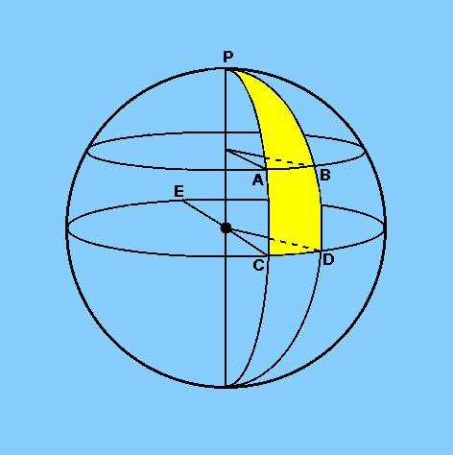
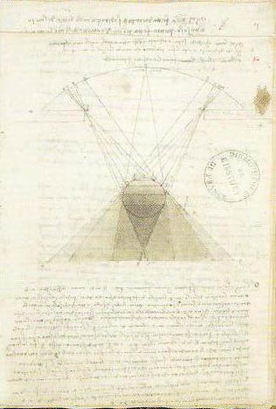
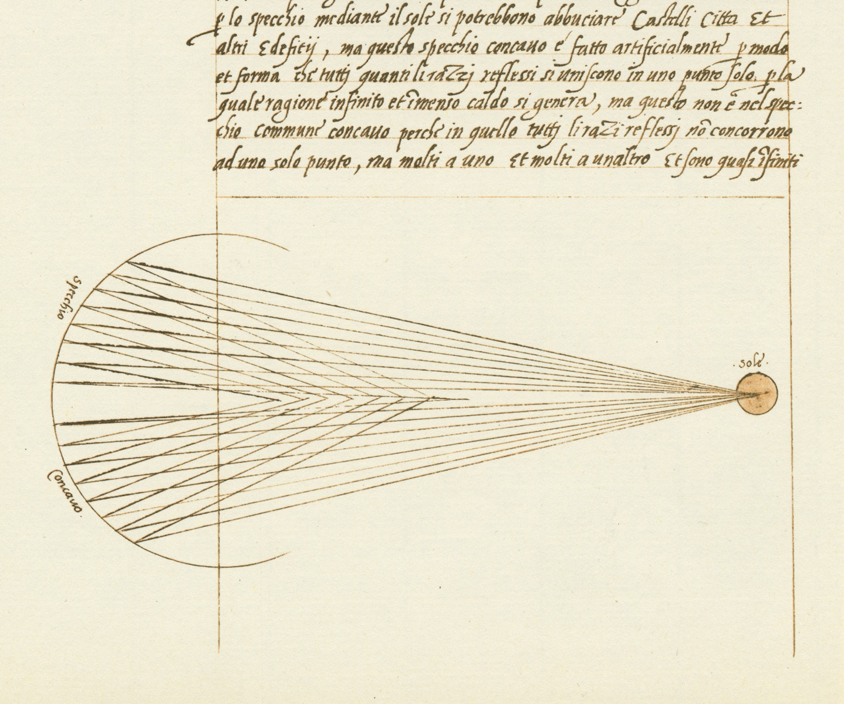
STS Across the Commonwealth
FRANCESCA FIORANI
UNIVERSITY OF VIRGINIA - ART DEPARTMENT
Research Focus
Research Question(s)
Recent Finding
Florence, Cathedral
Leonardo da Vinci,
Mona Lisa, 1503-1519
2020
2013
Leonardo da Vinci,
Optical Study, c. 1490
Diagram for Burning Mirror, 15th century
2012

Slide 13
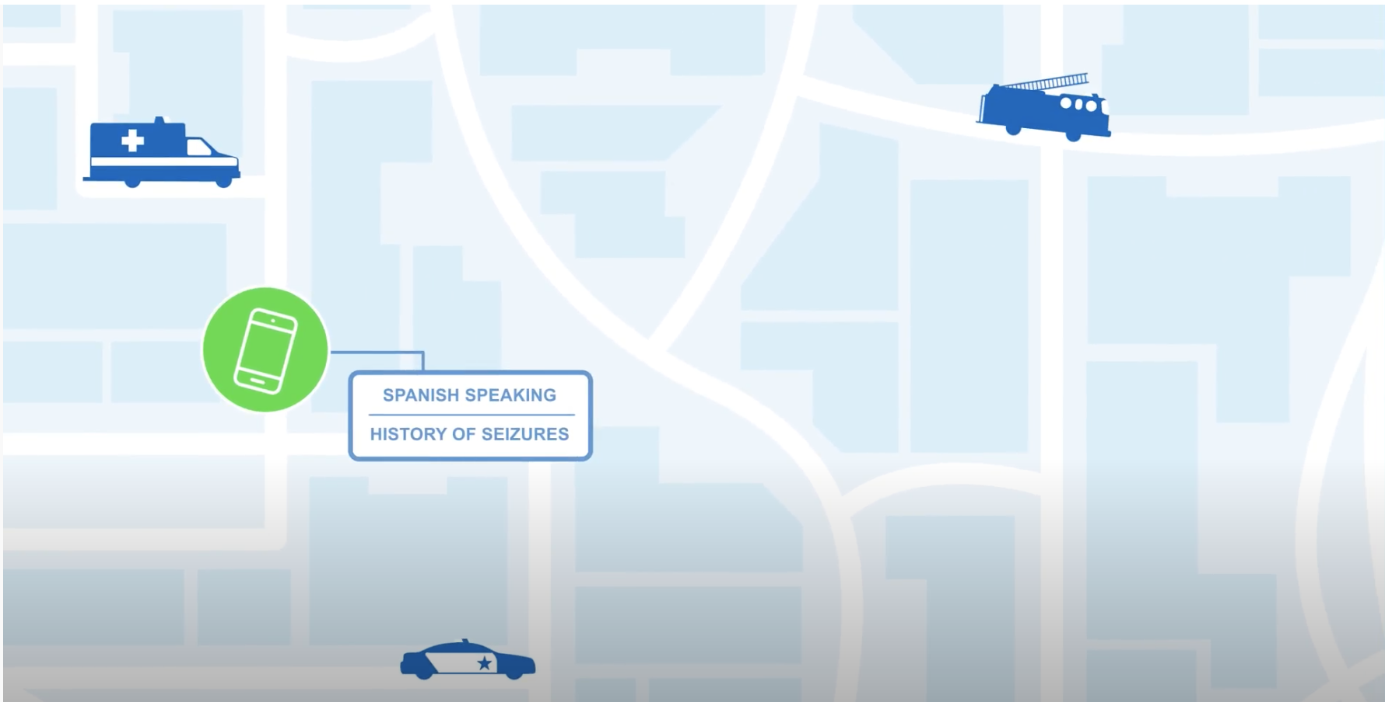
STS Across the Commonwealth
Elizabeth Ellcessor
University of Virginia
How do media systems define “emergency”?
How does this create or further societal in/equalities?
@trilliz lizellcessor.org

Slide 14
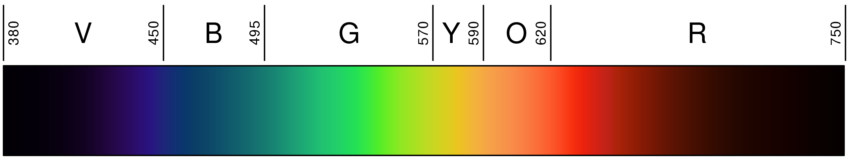
Peter Norton
Department of Engineering and Society
University of Virginia
norton@virginia.edu
What is full-spectrum innovation?
Consider the visible segment of the electromagnetic spectrum:
This is a truncated spectrum: a small fraction of the whole. Now consider the entire spectrum:
To understand our universe, the visible segment is not enough. A truncated spectrum misses far too much. We need full-spectrum science.
When we hear about “innovation,” it’s usually limited to a small but highly
conspicuous segment of the full sociotechnical spectrum of possibilities:
This is truncated innovation, confined to a very small subset of the possibilities. Now consider the full sociotechnical spectrum:
The greatest possibilities for full-spectrum innovation do not lie within any limited segment of the spectrum. They lie in the infinite combinations that are possible when the components of innovation are drawn as needed from across the entire spectrum.
Yet we tend to train people to limit themselves to narrow bands of the sociotechnical spectrum.
To serve our needs, truncated innovation misses far too much. We need full-spectrum innovation.
high tech
future tech
future sōsh
high sōsh
medium sōsh
low tech
medium tech
high tech
future tech

Slide 15
Lunch and Informal Conversations

Slide 16
STS across the Commonwealth
Lightning Talks
Session B

Slide 17


STS Across the Commonwealth
Gabrielle Adams, PhD
University of Virginia (Batten, Darden)
Gabrielle Adams, Ben Converse, Andy Hales, & Leidy Klotz (2021)

Slide 18

STS Across the Commonwealth
Claudia W. Scholz PhD
uva school of data science
The Data Justice Academy
Data Justice Seminar
Summer 2022 (June 5 – Aug 1)
Research Experience
18 Undergraduate Students
Underrepresented Groups
Apply Data Science to Social Change
  Health Disparities (3 projects)
  Economic Inclusion (2 projects)
  Democracy (3 projects)
KNOW: discern the unequal social impacts of dataficaton
FEEL: attune with communities resisting technological harm
THINK: discern the logic, theory, argument, and methods in tech discourse
DREAM: imagine alternatives to current systems
UNDERSTAND: map the social and technical systems involved in data science and AI
ACT: employ tools of auditing, advocacy and participatory policymaking to effect change
Learning Objectives
  Technical knowledge
  Sociopolitical, Ethical knowledge
  Personal & Professional Development

Slide 19
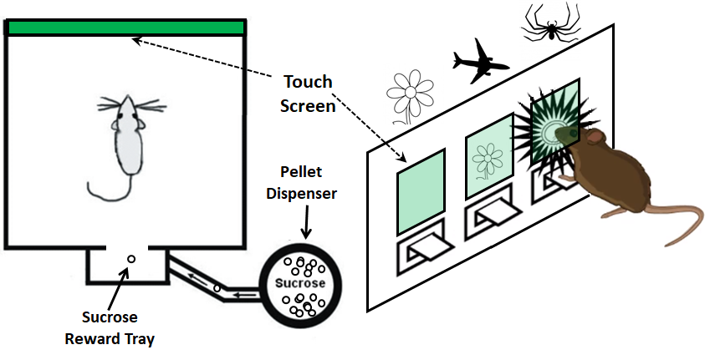
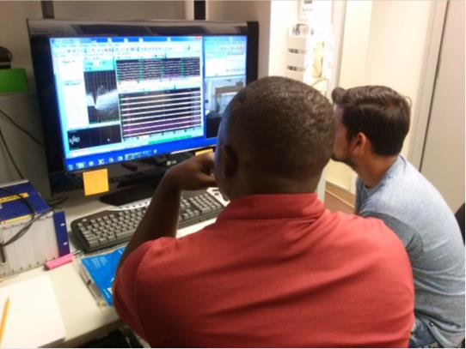
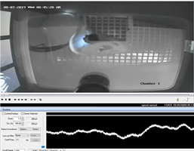
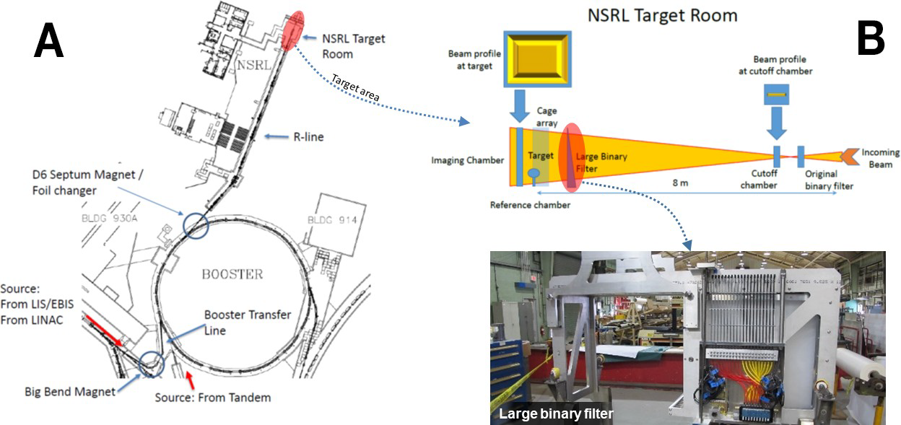
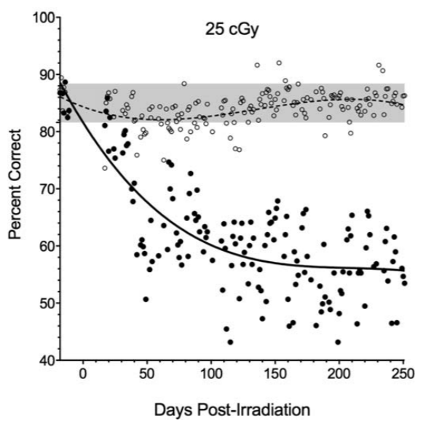
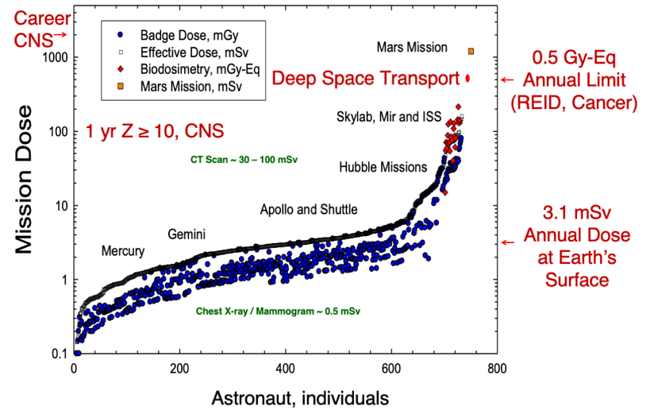
STS Across the Commonwealth
Hargsoon Yoon
Dept. Engineering, norfolk state university
Research Focus
Research Question(s)
Recent Finding
Space radiation significantly impact the central nervous system, and subsequently, crew cognitive and behavioral performance on long-duration missions.
Our research focuses on neural recordings of neural activities from multiple brain regions under various space radiation conditions.
The degree of synchrony between the regions has been understand how space radiation impacts to cognitive functions.
Functional studies of cognitive behaviors need to assess periods when tasks are being acquired and performed.
We should be able to measure neural signals from same behaviors under space radiation.
Our team in collaboration with Eastern Virginia Medical School demonstrated the first known recording of neural activity under severe radiation conditions in November, 2021 at NASA Space Radiation Research Laboratory in Brookhaven National Lab, New York.
Rule: Touch the screen with nose when a correct image is displayed on a designated screen.
This technique is expected to further catalyze studies that examine the effect of space radiation to cognitive functions of astronauts on deep space exploration.
Three different regions (cortex, hippocampus and amygdala) of rat brain are concurrently measured wirelessly while the rat is under a task.
Modified from Cusinotta et al. (2019)
Brookhaven National Lab
(Davis et al. 2014)

Slide 20
STS Across the Commonwealth
Hua Liu
Old Dominion University
Research Focus
Research Question
Recent Finding
An application of geospatial technologies in health
Quality of life includes different dimensions, e.g., physical, social, & political concerns
Geospatial technologies can integrate environmental and social-economic condition for health-related studies
To assess quality of life in Hampton Roads, Virginia in years 2010-2018 based on environmental factors and quality-of-life survey data
The results can facilitate the local governments in policy making and urban planning
Quality of life in Hampton Roads, Virginia varied across the region with somewhat consistent patterns throughout the years (2010-2018)
The Overall Quality of Life map should be appropriately used by local governments to allocate enough resources to those neighborhoods with lower rating on quality of life

Slide 21
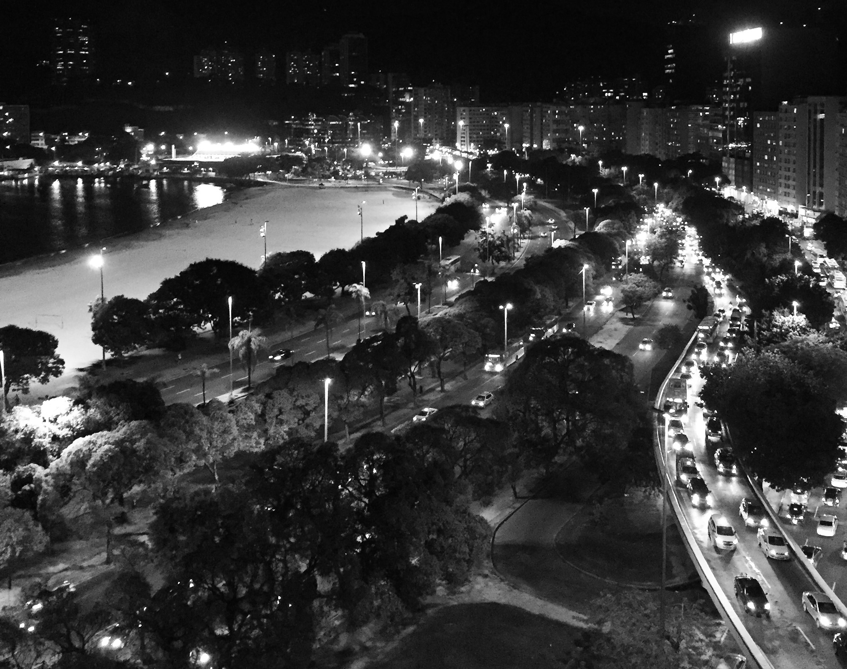
STS Across the Commonwealth
Jess reia
School of data science, university of Virginia
@jhereia
Research Focus
Research Question(s)
Recent Finding
Project: Urban Data for the Night (CAN/USA/MEX)
How does the lack of consistent data affect the 24-hour city and different stakeholders?
How can irresponsible data practices harm communities?
Research & advocacy that addresses power relations between technologies, spaces & people.
Critical Data Studies, STS, Policy & Law
Tech policy, Digital Rights, (Smart) Cities & Night Studies.
Latin America and Canada.
Nightlife as a complex ecosystem
Disconnection between smartness and night governance agendas
Open data policies are focused on the day
Controversial data-centric projects
Notions of cohabiting the night/spaces for marginalized communities
Harm/visibility (in datasets, for example) might not be desirable
No one-size-fits-all solutions
J. Reia CC BY-NC-SA 4.0

Slide 22
STS Across the Commonwealth
Galen Murton
James Madison University
Research Focus
Research Question(s)
Recent Finding
Academic analyses and policy reports indicate that the United States has reached a critical point of infrastructural crisis.
With poor and rural areas at a particularly precarious juncture, the Appalachian region is widely seen as emblematic of socio-economic collapse in 21stcentury America.
But as debates around infrastructure access and infrastructural finance circulate in national headlines and Congressional deliberations, a fundamental set of questions remains unanswered:
What counts as infrastructure in America?
Who gets to decide what counts?
For whom are infrastructures funded and developed?
At what costs are infrastructures built, repaired, or neglected?
Taking these questions as a starting point of both inquiry and analysis, this project works to conceptualize a social imaginary of American infrastructure which can then be articulated, leveraged, and mobilized for civic infrastructural action across the nation.
By fundamentally recognizing what’s the matter with infrastructure in America in social and material ways, viable practices and policies of infrastructural justice might finally be achieved…

Slide 23
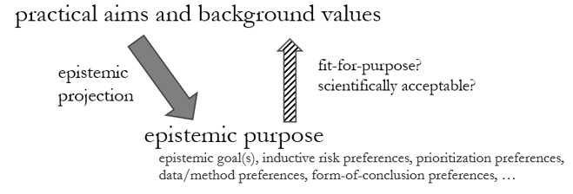
STS ACROSS THE COMMONWEALTH
Wendy Parker
Department of Philosophy, Virginia Tech
Research Focus
Research Question
Recent Finding
Scientific methodology, modeling and computer simulation, data, evidence, values, climate science
I investigate:
  how climate models can be used and evaluated
  how complex data sets are produced
  how research can take account of contextual values
How can contextual values appropriately shape research?
Richly-conceived epistemic purposes

Slide 24
STS Across the Commonwealth
Kristen Koopman
Virginia Tech
Research Focus
Research Question(s)
Recent Finding
“The technical” and “the social” are constructed as mutually exclusive in speculative fiction, even in reader responses
Scientific authority is used to back up this construction, even though in science fiction facts are fundamentally made up
Do scientific values associated with inequality in science have similar effects in informal scientific settings?
Freedom from bias
Rigor
Realism
Empiricism/replicability
Scientific authority exerts power along the technical/social binary outside of formal technoscientific settings
Implies cultural baggage that might not be sufficiently addressed in education/professionalization
Might explain upstream recruitment/retention issues in STEM

Slide 25
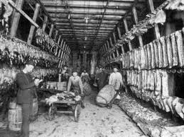
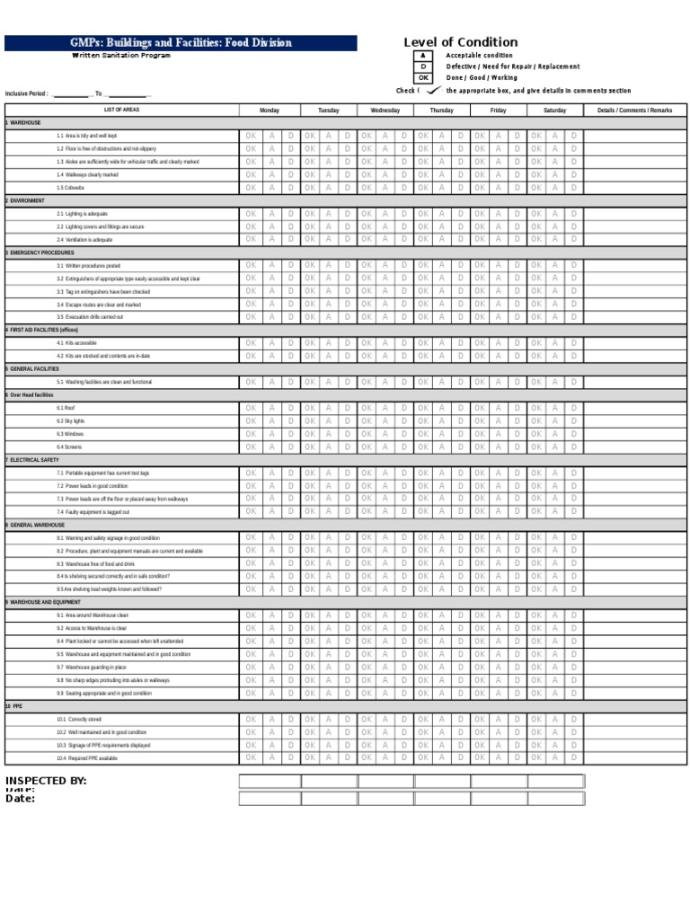
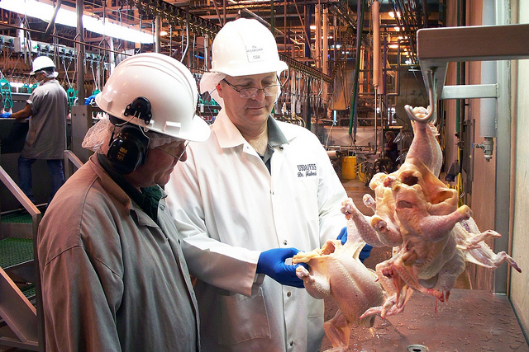
STS Across the Commonwealth
Saul Halfon
STS, virginia Tech
Research Focus
Research Question
Recent Finding
Contemporary US Food Governance at the USDA – food safety and food security.
Food governance is often framed in terms of risk and danger. I explore how the USDA uses technical practices to frame particular risks and dangers for regulation.
I have been focusing most recently on the regulation of meat safety in slaughterhouses.
How do US governing institutions think about meat safety?
Abstractly: A new framing of the problem of food safety suggested new kinds of solutions that carry new values and practices, giving rise to new implications that are being framed as new problems to be solved.
Concretely: the rise of new microbial contaminants along with articulated barriers to innovation served as an argument for policymakers to move from organoleptic to process- and audit-based meat inspection, which shifted regimes of expertise, trust, professional practice, labor, animal care, and responsibility, as well as the meaning of safety and goals of inspection.

Slide 26

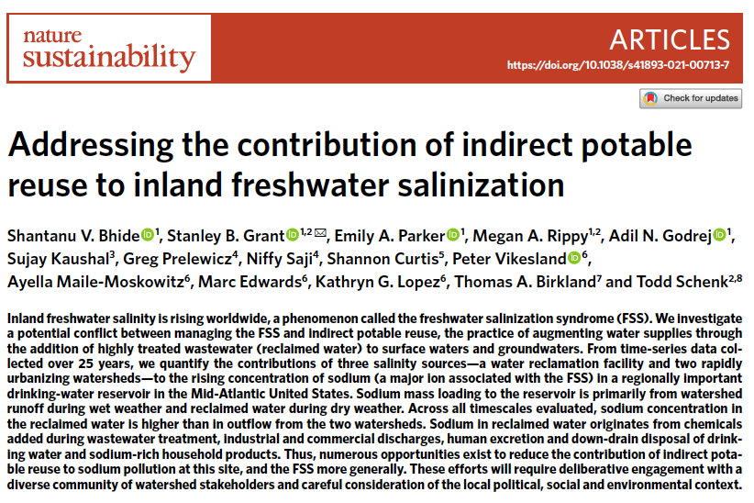
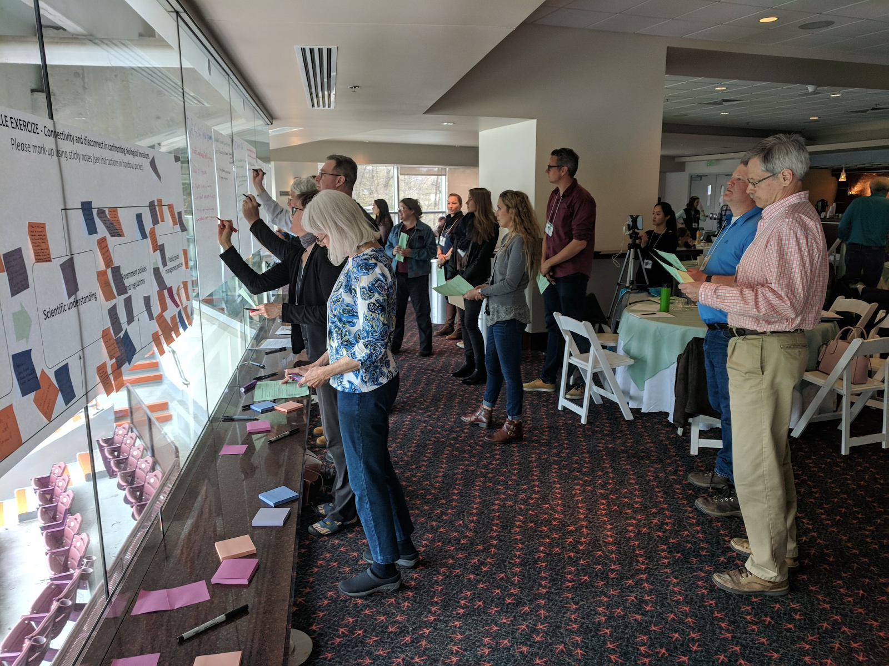

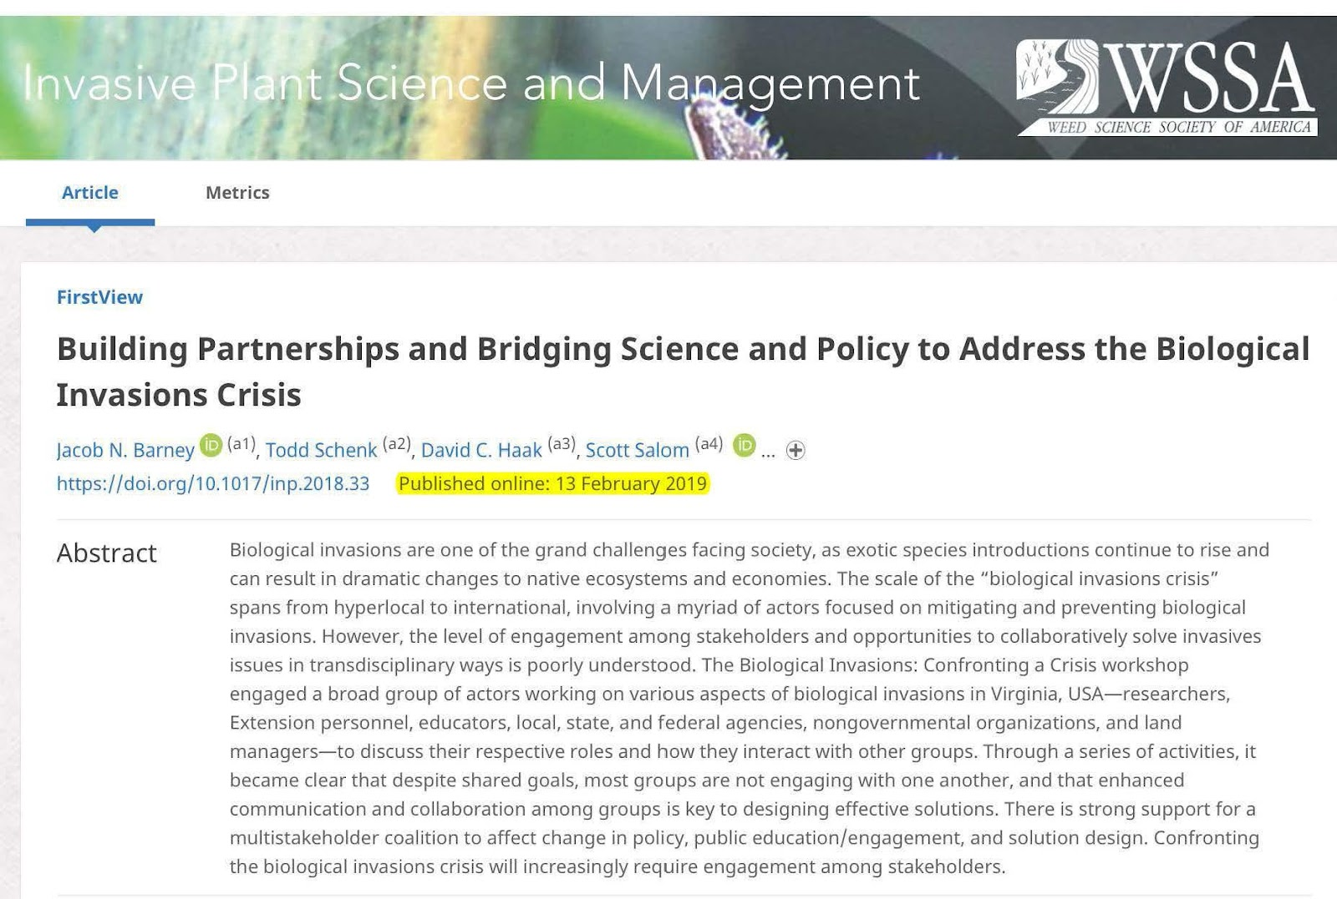
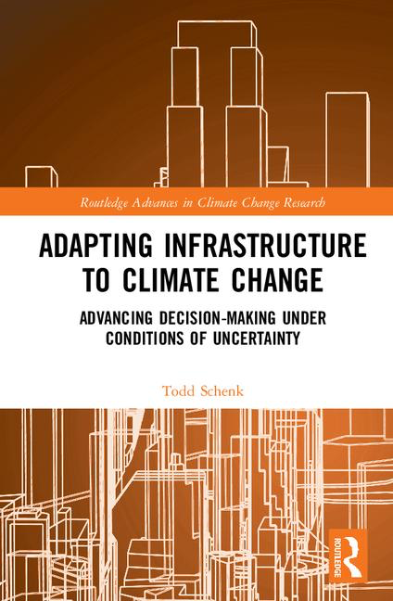
Todd Schenk, PhD, MCP
Associate Professor – School of Public & International Affairs
Director – Science, Technology & Engineering in Policy (STEP) Program
Faculty Affiliate - Global Change Center, Fralin Life Sciences Institute, and Center for Coastal Studies
Program goal: Develop and enhance STEM-H students, practitioners, and scholars’ understanding of policy processes and capacity to integrate scientific and engineering knowledge with public policy reasoning.
www.step.vt.edu
COLLABORATIVE GOVERNANCE AT THE SCIENCE-POLICY INTERFACE

Slide 27
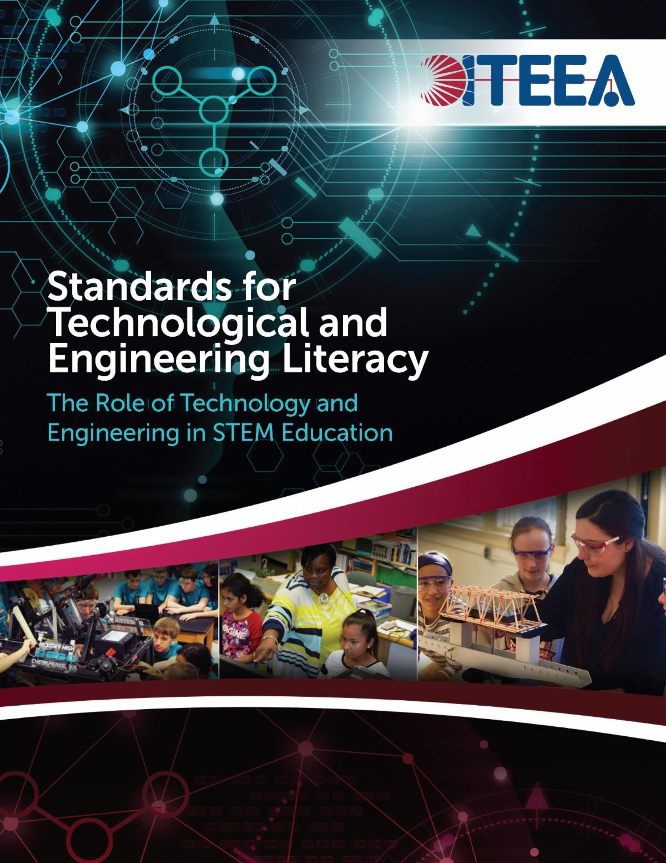
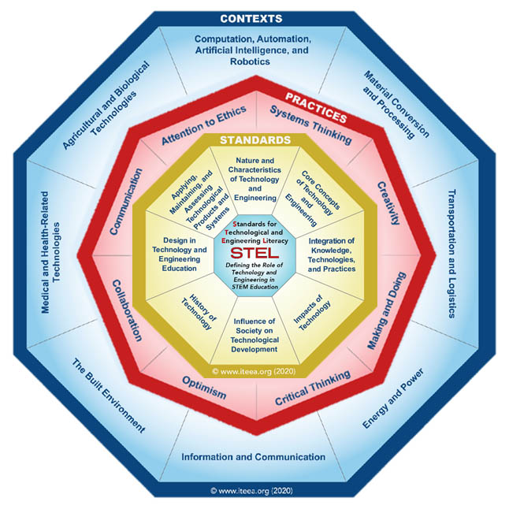
STS Across the Commonwealth
Philip A. Reed
Old Dominion University
Research Focus
PK-12 Career & Technical Ed
  Agricultural Education
  Business & Info. Technology
  Family & Consumer Sciences
  Health & Medical Sciences
  Marketing Education
  Technology & Engineering Ed.
  (Design & Technology)
  Trade and Industrial Ed.
Workforce Education
STEM Education

Slide 28
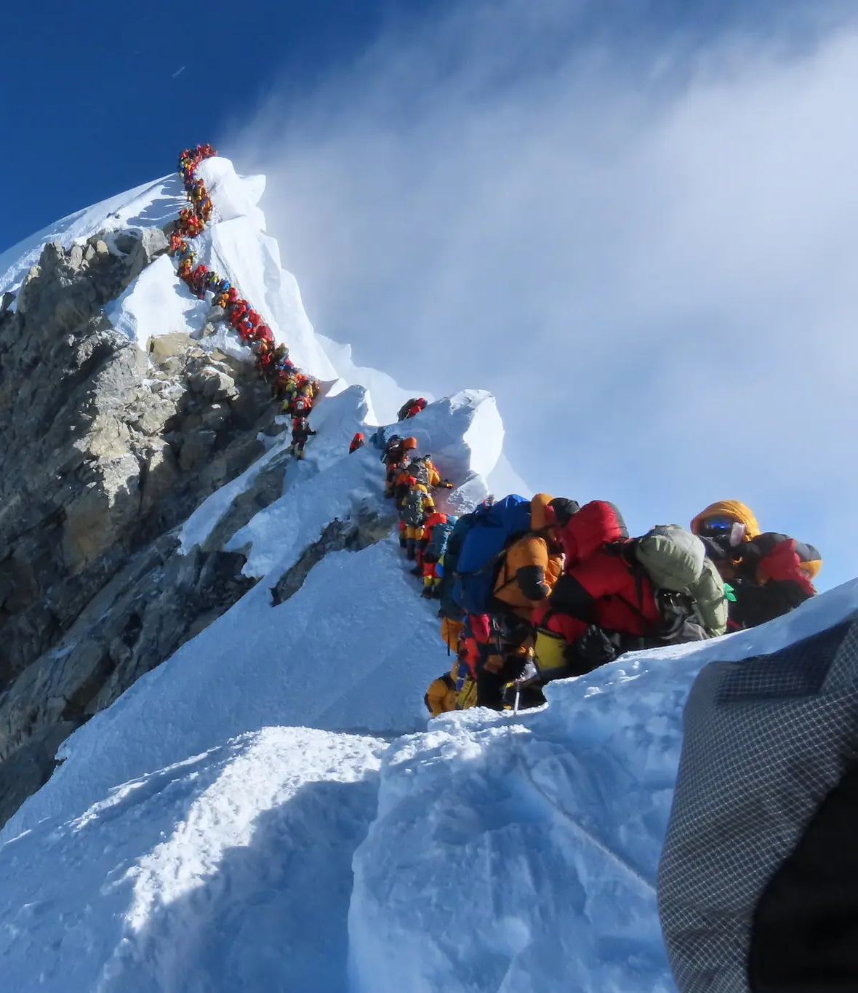
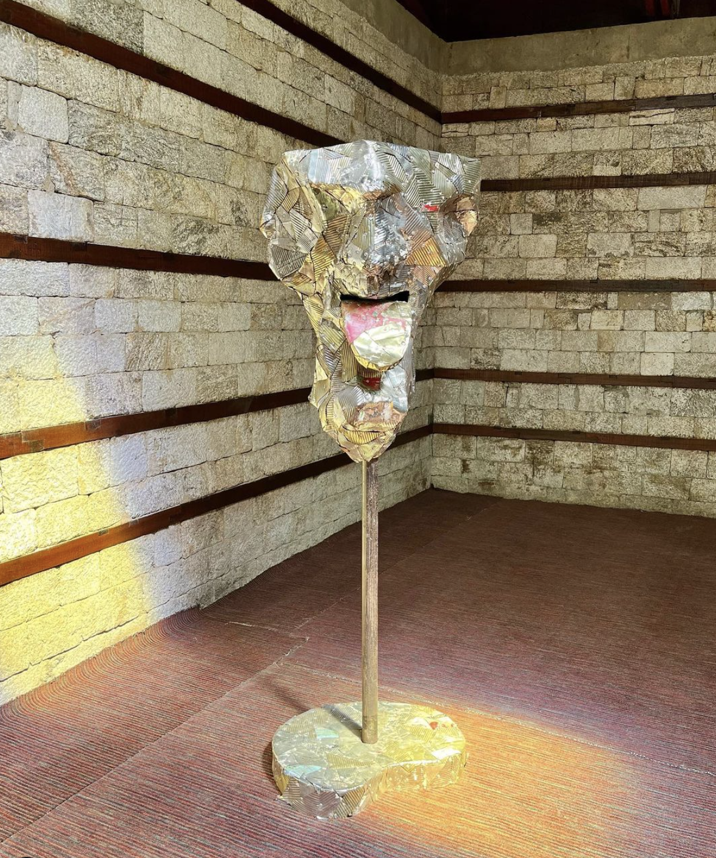
STS Across the Commonwealth
NADINE PLACHTA
UnIVERSITY OF TORONTO
Research Focus
Research Question(s)
Recent Finding
With more and more people visiting Mount Everest each year, the Khumbu region has grown increasingly polluted
Discarded plastics on the mountain and in villages landfills have led to a contamination of the local watershed
Health and environmental concerns complicate the effects of climate change for local communities
As new challenges develop in the Khumbu region, creative practices emerge to reduce waste accumulation
How does the visible presence of plastics in mountain landscapes motivate environmental action?
Sagarmatha Next, a local initiative in the Khumbu region, has a solution for the waste that climbers produce: it bridges arts and science to develop solid waste management strategies and work for sustainable futures
Nimsdai Purja, 2019
Roshan Mishra, 2022

Slide 29
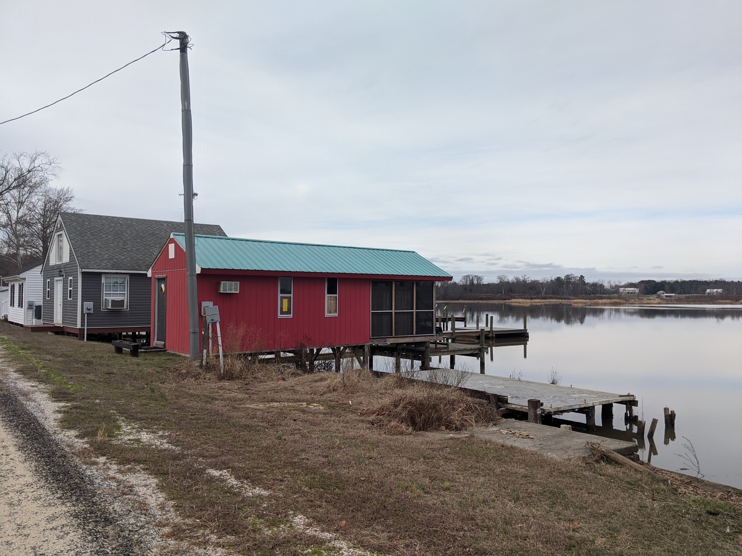
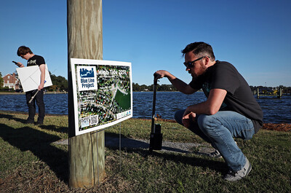
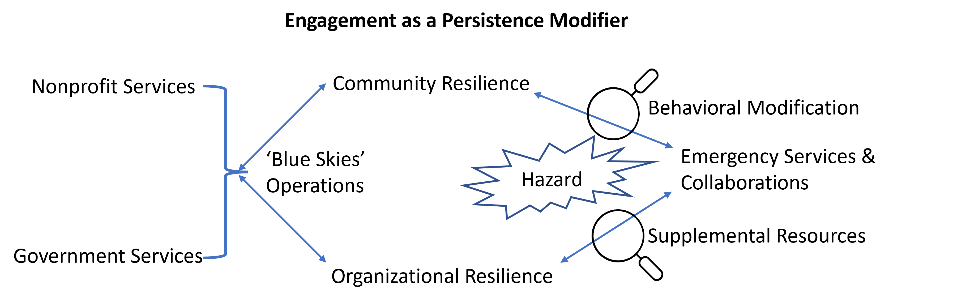
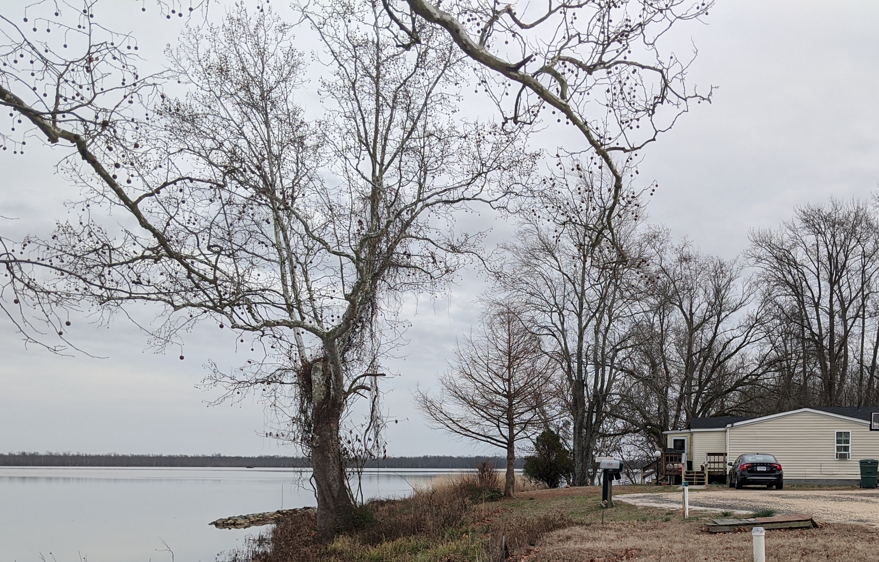
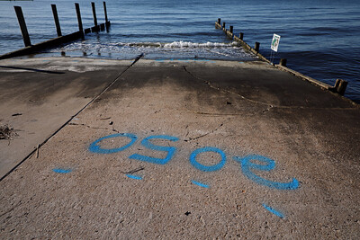
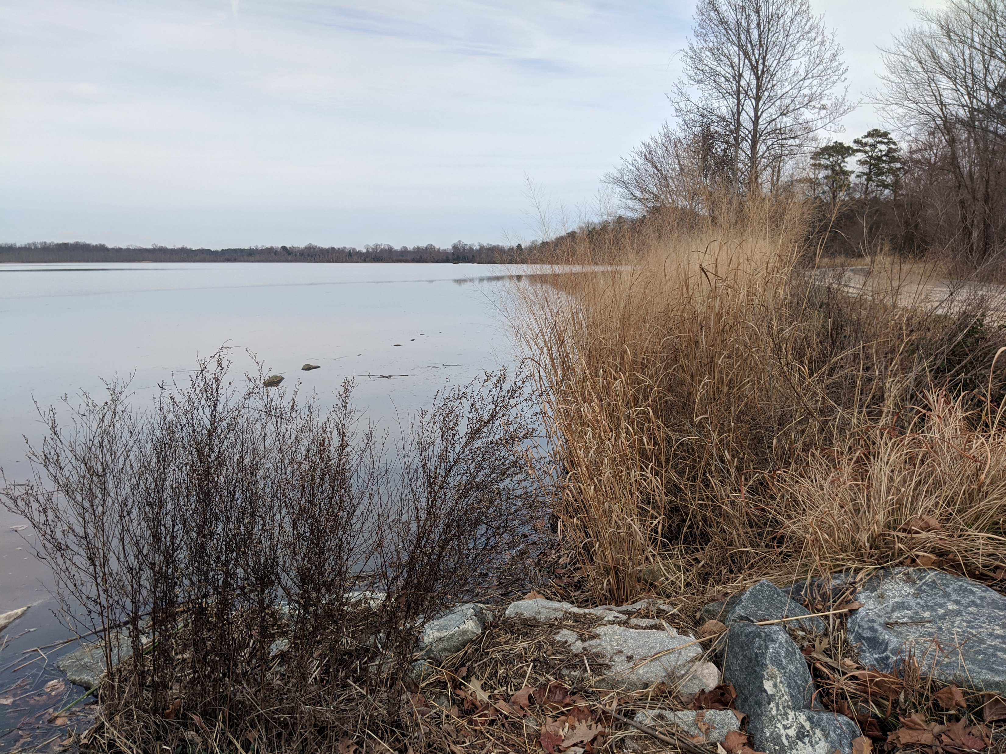
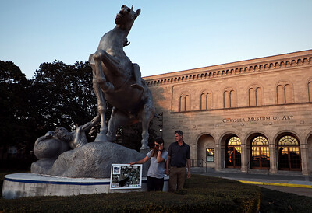
Engagement as a Persistence Modifier
Nicole S. Hutton, Ph.D.
Old Dominion University
@ VA Sea Grant
@ VA Sea Grant
@ VA Sea Grant
Sea level rise mitigation priorities on the Pamunkey Indian Reservation
Hurricane evacuation transportation priorities in
Hampton Roads
Sea level rise mitigation priorities in Norfolk

Slide 30

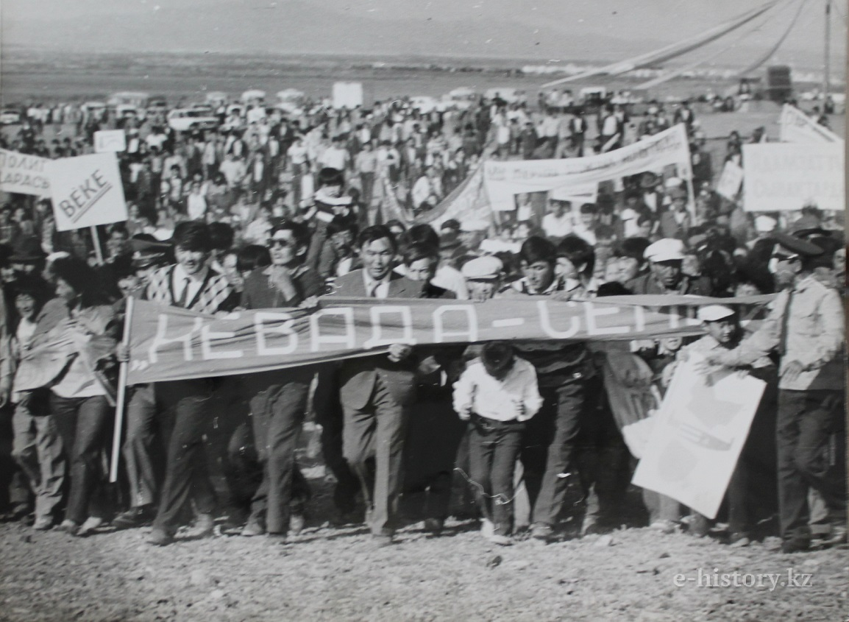
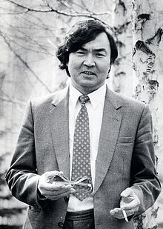
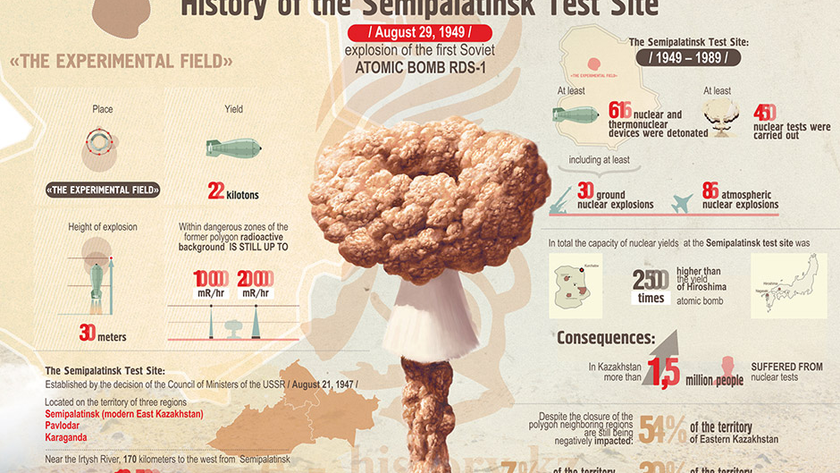
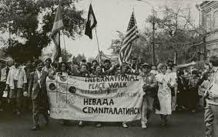

Lessons from Kazakhstan’s Nevada-Semipalatinsk anti-nuclear movement
Kulyash Zhumadilova, Virginia Tech
Underground explosions on February 12 and 17, 1989
February 28 – The House of Writers
February – April 1989 – 7 petitions (approx. 2 million signatures)
October 21-23, 1989 – protests
August 29, 1991 Polygon was closed
December 16, 1991 Kazakhstan celebrated its Independence Day
Disarmament and non-proliferation as focus in international policy
Ecology and environmentalism
co-opted by establishment
Back to nuclear?

Slide 31
STS across the Commonwealth
Lightning Talks
Session A

