Slide 1
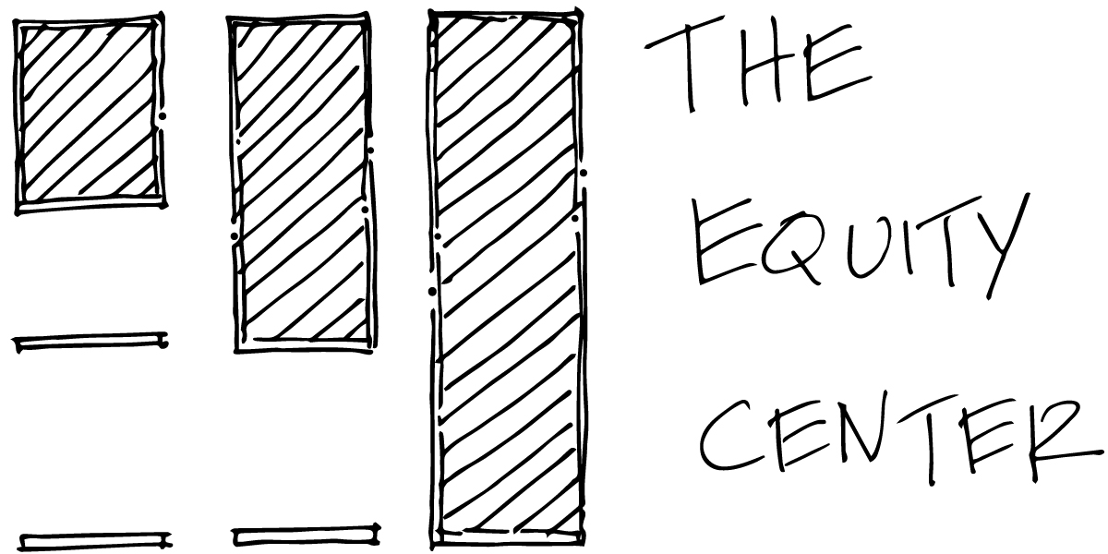
Dr. Sherica D. Jones-Lewis
Director of Community Research
For
Science, Technology and Society
Notes:
Good afternoon and welcome to the Community Engaged Research workshop. I hope that everyone enjoyed their lunch and is nourished enough to be able to participate in the session today. Now, let's get started.

Slide 2
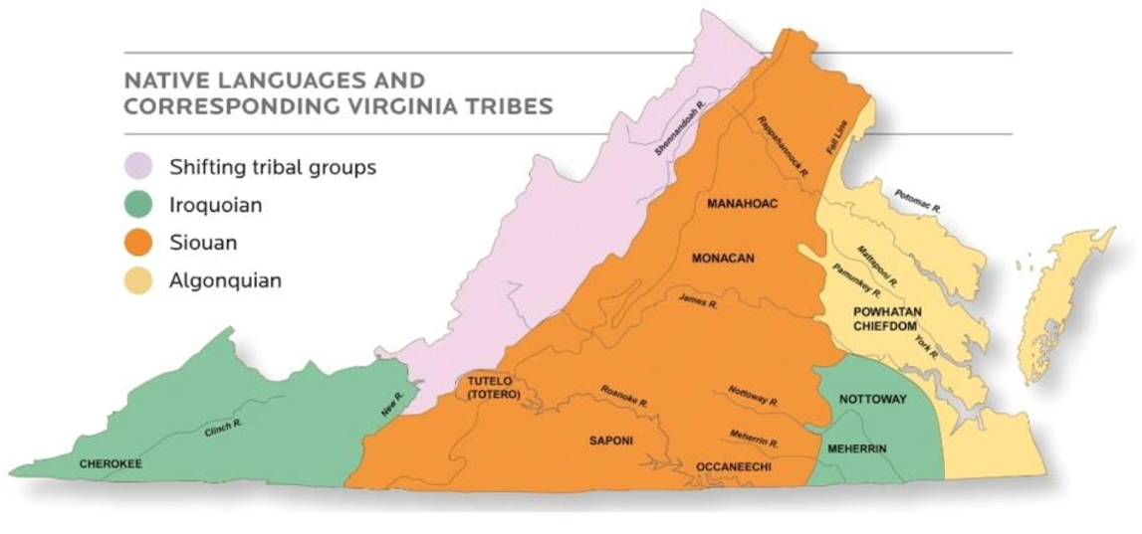
Land Acknowledgement
Creating a truly diverse and inclusive environment is a challenge for any institution. At UVA, this challenge is particularly acute because of the University’s specific history.
The University was designed to educate southern white gentlemen. It was built by enslaved laborers, on Monacan tribal land, and enslaved and free Black people provided the labor and capital that supported the students and faculty through the Civil War. In the twentieth century, the University was a pioneer in the eugenics movement and supported segregated schools. The education denied to Indigenous nations was publicly acknowledged by what is now recognized as the Commonwealth of Virginia in 2007, yet few institutions have made significant progress on increasing the representation of Indigenous students.
We at UVA will continue to seek opportunities to engage in meaningful relationship building for our shared futures and acknowledge with respect that we live, learn, and work on the traditional territory of the Monacan Indian Nation. We pay respect to their elders and knowledge keepers past, present, and emerging.
Notes:
Before, we go any further today, we want to be reminded that:
UVA was built by enslaved laborers, on Monacan tribal land, and enslaved and free Black people provided the labor and capital that supported the students and faculty through the Civil War. In the twentieth century, the University was a pioneer in the eugenics movement and supported segregated schools. The education denied to Indigenous nations was publicly acknowledged by what is now recognized as the Commonwealth of Virginia in 2007.
With that....

Slide 3
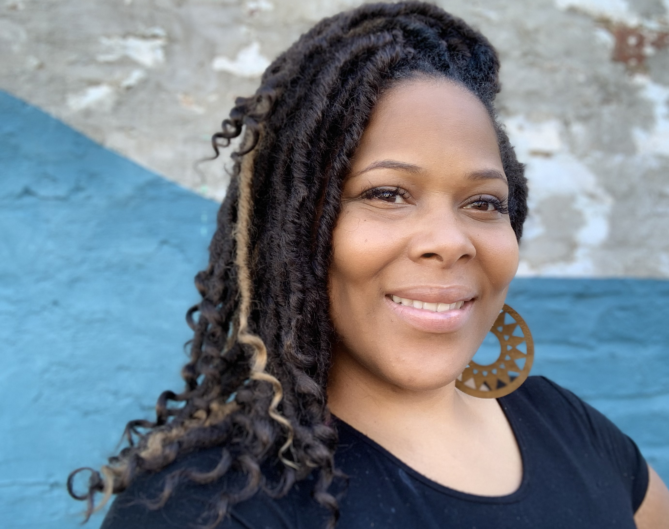
Dr. Sherica D. Jones-Lewis Director of Community Research The Equity Center at UVA
Notes:
My name is Dr. Sherica Jones-Lewis and I am the Director of Community Research at The Equity Center at UVA, where I work with students, faculty staff, and most importantly community members and organization to carry out the mission of the Equity Center.
Our mission is to...

Slide 4
Mission and Vision
MISSION
The Equity Center will tangibly redress racial and economic inequity in university communities...
VISION
The Equity Center envisions universities that serve local communities by bringing rich research resources to bear on the work of redressing poverty and racial inequality...
Notes:
So what is our mission:
MISSION
The Equity Center will tangibly redress racial and economic inequity in university communities by advancing a transformative approach to the fundamental research mission, which will, in turn, reform institutional values, pedagogy, and operations
Our vision:
VISION
The Equity Center envisions universities that serve local communities by bringing rich research resources to bear on the work of redressing poverty and racial inequality, and also equip students to lead in building a just society.

Slide 5
Equity Center Values
Authentic Partnership
Shared Power
Equity
Justice
Beneficial
Action
Mutuality
Youth
Notes:
Now, I know what all of you are thinking. So what! Right! Many companies, schools, and orgs have vision, mission, and values statements that appear on the website, in annual reports, and conversations when talking to funders, and our do to, but they also live in the work that we do, and we are always checking ourselves and others when it come to the centering of our mission.
I am hopeful that by now you have been able to make the connection between my work and work of my colleagues at the Equity Center to community engaged research, it is, in essence what we do connect to community engaged research.

Slide 6
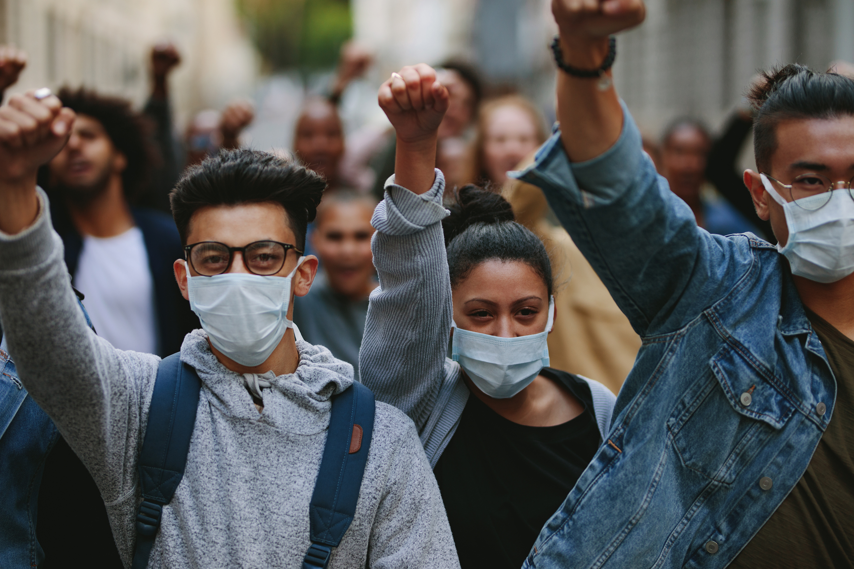
Why
“The idea of citizen participation is a little like eating spinach: no one is against it in principle because it is good for you. Participation of the governed in their government is, in theory, the cornerstone of democracy—a revered idea that is vigorously applauded by virtually everyone. The applause is reduced to polite handclaps, however, when this principle is advocated by the have-not (Black People), Mexican-Americans, Puerto Ricans, (Native Americans), (Inuit People), and whites. And when the have-nots define participation as redistribution of power, the American consensus on the fundamental principle explodes into many shades of outright racial, ethnic, ideological, and political opposition.”
Sherry R. Arnstein, “A Ladder of Citizen Participation,” Journal of the American Planning Association
Notes:
Community engagement or citizen participation is an idea that not many people disagree with, in fact Sherry Arnstein, who will talk a lot about today describes it as being similar to eating spinach!
No one will disagree that it shouldn't be done, at least at first, but when this is applied to certain groups of people and when these people define participation as the redistribution of power there is often, not just light resistance but an explosion of opposition.
So if, you, or your organization want to engage the community, but not Black folk, Latinx folk, Native folks, rural folks, poor folks then you are missing the mark, that is to say...

Slide 7
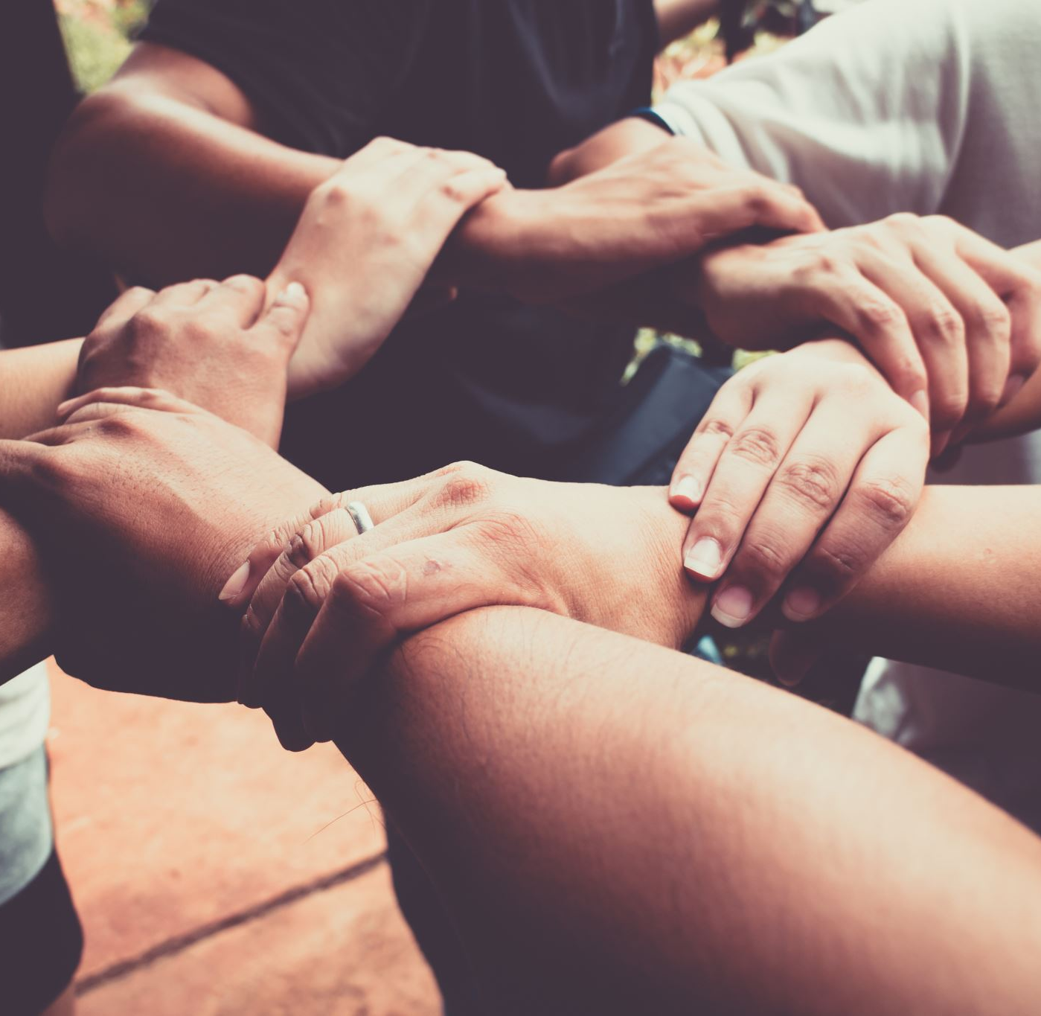
Don't let your attempts at Community Involvement be performative. How does the work that you do align with your overall vision, mission, and values
Notes:
That I want to caution you
Don't let your attempts at Community Involvement be performative.
Instead really work to see how the work that you do aligns with your vision, mission, and values or does not, and if the alignment doesn't exist it might be time to take another look.

Slide 8
“If you do what you’ve always done, you will get what you’ve always gotten"
Equity Center Value | Traditional Research Approach | UVA Equity Center Research Approach
Authentic Partnership | Absence of partnerships, or superficial involvement with community partners | Research WITH community members that is authentic, honest, and transparent in an iterative manner.
Shared Power | Academic institution/s hold power and actively work to maintain using both direct and indirect means | Power is shared between the community members/orgs and the academic institution with. Care is taken to recognize and redress
Equity | Academic intuitions steer clear of social justice issues or advocate in ways convenient for them. Community knowledge is not respected or compensated. | Academic institution advances social justice, WITH community partners. Community experts are respected and compensated.
Justice | Justice for those impacted by the research is a distant goal for some. | Justice is foregrounded. Research contributes to the fair distribution of equal, basic rights to all members of society.
Notes:
Equity Center Value
Traditional Research Approach
UVA Equity Center Research Approach
Authentic Partnership
Traditional Research Approach - Absence of partnerships, or superficial involvement with community partners
Equity Center Approach - Research WITH community members that is authentic, honest, and transparent in an iterative manner.
Now let’s take a few minutes to discuss. At your table please talk about what you have heard so far. Consider:
1. This lady is crazy!
2. Does the idea of community engaged research fit with the vision, mission, and values of my organization
3. What about my own values

Slide 9
Some examples of my work and the work of my Equity Center Colleagues
RRR – Residents for Respectful Research
COVID19 Wraparound Support
Work with CFRs – Community Fellows in Residence
Democratization of Data
Notes:
I am hopeful that you enjoyed the opportunity to talk with other attendees. We have baked in more time for you to do so later. Right now I want to tell you about some of the community engaged work that the Equity Center is engaged in.

Slide 10
RRR Residents for Respectful Research
The purpose of Residents for Respectful Research (R3) is to assure that public housing residents understand, have input to, and benefit from research conducted on/with public housing residents – whether that is by senior faculty or students. There is widespread concern among public housing residents of how research data are used, and how their lives are represented. In addition to rarely receiving the benefits of research done in their communities, uncoordinated research places time burdens on residents. For example, many have to answer basic demographic, economic or health status questions whenever a project gets started.
Notes:
RRR – The Equity Center has partnered in order to support PHAR (The Public Housing Assocation of Residents in order to create Residents for Respectful Research, this community board of the SBS-IRB is made up of residents of public housing who are working on their CITI training so that they can review protocols that impact or study the local community.
The hope is that as the group progresses they will propose and be supported to carry out their own research as well.
The trajectory is input, to benefit, to researchers!

Slide 11
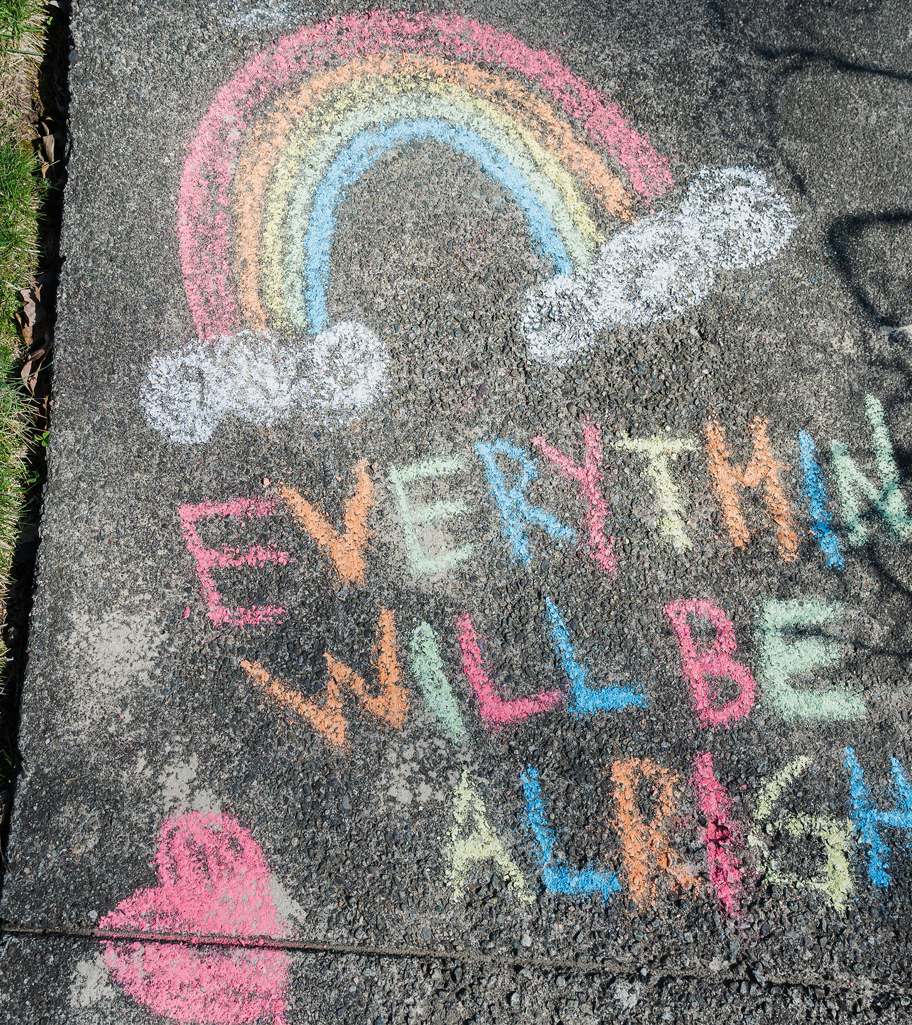
COVID19 Wraparound support program – How?
Work
Necessary Intervention/Funding
Evaluation
Change
Notes:
My next example is actually a program evaluation. I want to point out that indeed evaluation and research are not the same, but they have a lot of similarities and this example is one that truly illustrates the ways in which we work.
A JOINT EFFORT OF THE FOOD JUSTICE NETWORK - CULTIVATE CHARLOTTESVILLE AND THE EQUITY CENTER
As the local COVID19 pandemic raged, data illustrating disproportionate impact faced by African-American and Hispanic households in comparison to white households not only highlighted disparities in exposure but also in recovery and mortality. Black and Brown residents in the Blue Ridge Health District make up a smaller share of the population yet carry a substantial share of disease burden, recovery complications, and death. In order to increase access to COVID-19 testing, address misinformation, and tackle stigma related to COVID-19 within low-wealth, predominately African American and Hispanic communities, faith leaders and public health officials collaborated to offer free, focused testing events. Two days a week, wraparound resources were aggregated and dispatched across Charlottesville and Albemarle to COVID-positive households through the delivery support of Dept of Human Services and Blue Ridge Health District Medical Reserve Corps.

Slide 12
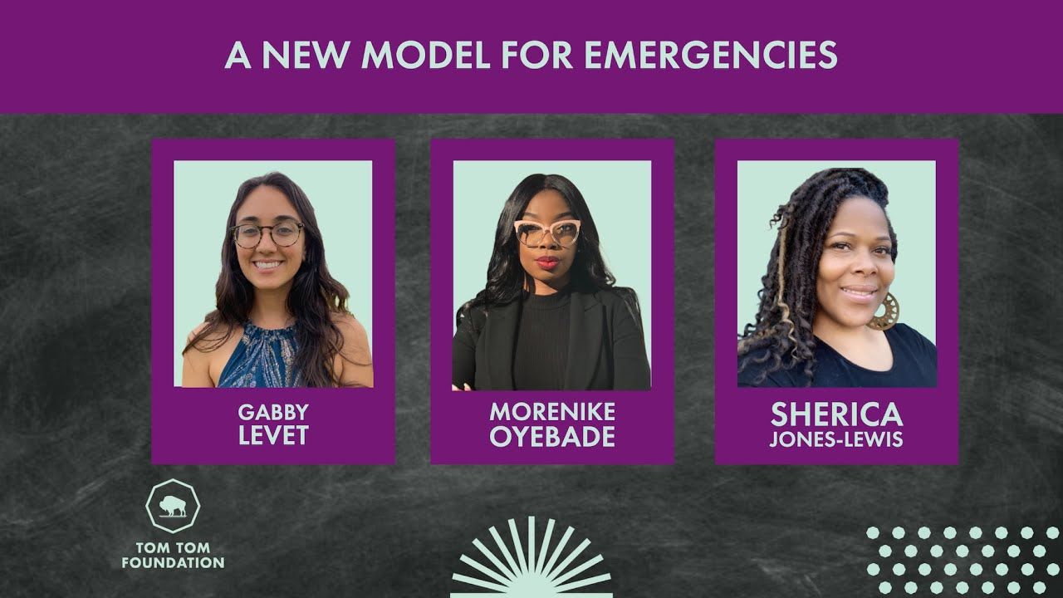
COVID19 Wraparound Support Program
Notes:
It is important to know that this program evaluation was not the only Equity Center effort, rather it was combined with a Recovery Data, a Frontline Workers Charter to ensure that many of our workers were being paid and able to provide for their families during the height of the pandemic and other efforts.
However, and this is key when it came time to share about and indeed get credit for the work that had been done and evaluation of it, the community members and organizations were highlighted. In this manner community engagement should work in an iterative manner.
COVID-19 SUPPORT
To Be a Good Neighbor
Frontline Workers Charter
COVID-19 Recovery Data Hub
COVID-19 Wraparound Services Program Evaluation

Slide 13
Equity Center Community Fellows in Residence Program
Benita Mayo - DOCUMENTARY PHOTO SERIES ADDRESSING MATERNAL HEALTH DISPARITIES OF AFRICAN AMERICAN WOMEN
Notes:
The Community Fellows-in-Residence (CFR) Program is a short-term, professional development opportunity run by the University of Virginia (UVA) Equity Center designed for individuals who have a history of actively working to reduce racial and socioeconomic inequality in our community and have a special project that could benefit from access to UVA support and resources.
Benita Mayo was a fellow in our 2021 cohort and her project was a documentary photo series addressing maternal health disparities of African American women. We provided here with the research support necessary to frame the work that she was doing, and to meet her goals
So how did it go?

Slide 14
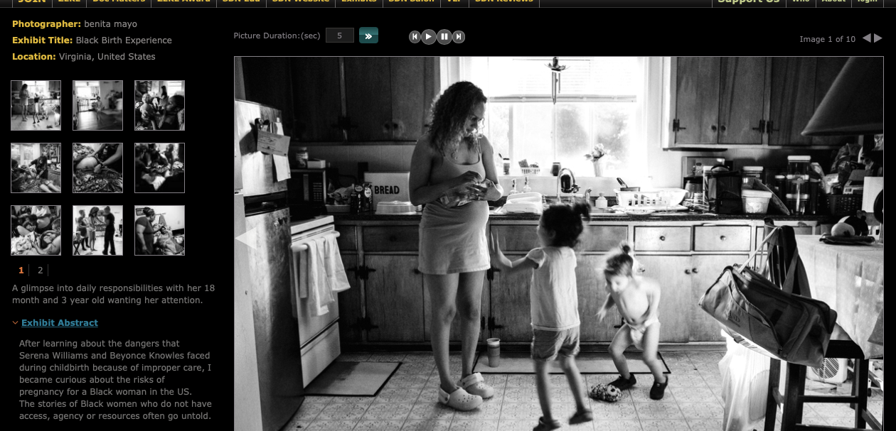
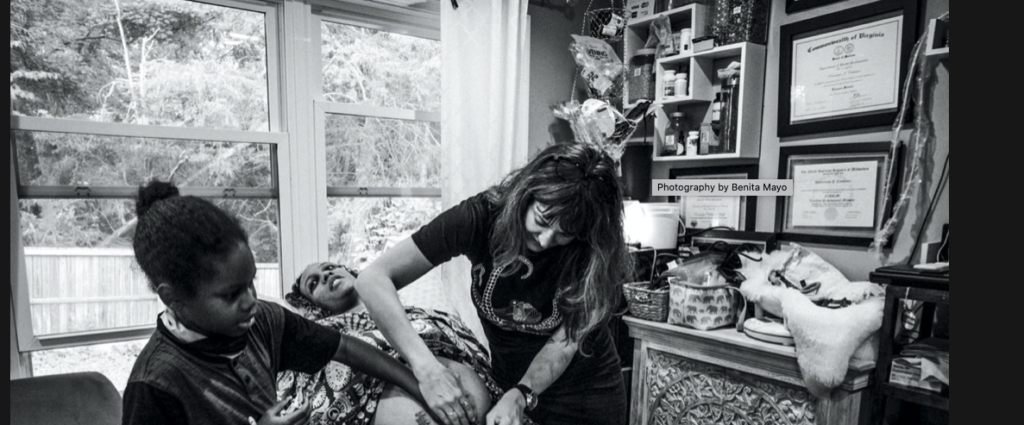
How it went...
Photos by: Benita Mayo
Notes:
The second photo is from: Bearing Witness A #VQRTrueStory Essay, Benita provided the photos for the essay and worked to craft the narrative. Her work is being used to advocate for doulas to be included in hospital birthing processes and to change the culture of maternal support here at the University.

Slide 15
Equity Center Community Fellows in Residence Program
Edgar Lara and Maria Esparza-Rodriguez - CONECtA2
LATINX Leadership in Charlottesville is a program designed to train and mentor the future Latinx leaders of Charlottesville. Ultimately, we hope that these leaders will gain the skills necessary to engage and share their knowledge with other people in both the Charlottesville and UVA communities.
Notes:
Another CFR project came to us from Edgar Lara and Maria Esparza Rodriguez.
Conecta2: Latinx Leadership in Charlottesville is a program designed and developed collaboratively by Edgar and María to train and mentor the future Latinx leaders of Charlottesville. At a particularly difficult time of social and political tensions, and in response to some of the challenges brought by the COVID-19 pandemic, this program will train, support, and empower future Latinx leaders from the Charlottesville area. Through his extensive contact with the local Latinx community Edgar has learned that the lack of technological literacy among low-income, monolingual immigrants, and adult Latinx people in the region is one area that requires attention and improvement. We propose to use the fellowship and the resources provided by the Equity Center to design a program to empower, educate, train, and encourage public engagement and participation among local Latinx leaders. Specifically, the program will focus on helping the participants achieve technological literacy, learn about and discuss issues that are important to the Charlottesville Latinx community, find and share resources, and learn the skills and tools to work both independently and collaboratively.
We provided research support to Edgar and Maria around curricular development, best practices, and more on an as needed basis, so how did it go?

Slide 16
How it went...
2 successful iterations of the program
Technology for Latinx Leaders
Curriculum development
Capacity for improvement
3 of the graduates are new CFRs
Conecta2 @ Sin Barerras where Edgar Lara is now the ED!
Notes:
Just read the slide:
Now I know that I kind of glazed over the second to last point there, but I want to talk a bit more about the fact that there are many times that programs and research alike, do not lead to change; but this was not the case with Edgar and Maria's project.
I went very well, and...

Slide 17
And went...
Jose Luiz Hernandez and Ramiro Vasquez are graduates of Conecta2, 2021 Community Fellows-in-Residence Edgar Lara and Maria Rodriquez Esparza’s digital literacy course. Their project will be designing a Spanish-language driver’s education curriculum to assist recent immigrants to obtain their Virginia driver’s license.
Notes:
[English translation: In 2020, a law passed provided the opportunity to obtain a driver's license regardless of immigration status. This was a huge win for everyone, creating something that will make the roads safer and help the state financially. However, the reality is that many want to take advantage of this but face challenges as many did not have the opportunity to finish primary or secondary education. For these people, passing the knowledge test is a great challenge. This program will focus on supporting this group.]
They have already since January met with law makers and even gotten some questions of the Spanish version of the state driving test changed!

Slide 18
A MAJOR Foundation What?
Part of a research team providing research support to a wide variety of BIPOC organizations who have received funding in order to think more deeply and implement actions that will lead to deeper understanding of their current state and the ways in which changes will allow them to more readily engage on and with their local communities.
Notes:
As part of my work at the EC I am working with a group of likeminded researchers to provide research support for a group of BIPOC led organizations across the country, and while the call was traditional, the proposal that we submitted was in-line with the EC vision, mission, and values and we were chosen to do the work!
That is to say, this work can be done even when there are outside pressures and funding.

Slide 19
LARGE foundation How it's going...
1. Definitional work around the foci of terminology
2. Definitional work around the project questions
3. Planning year to work with the arts organization on how they define and frame success
Notes:
Read the slides
It can be done

Slide 20
Democratization of Data What and How.
Overview: The Democratization of Data Initiative centers community-driven partnership to provide advocates as well as civic-and private-sector leaders with data and metrics, contextualized analysis, interactive maps and data visualizations, and narrative storytelling as a resource in pursuit of equity throughout the region.
https://youtu.be/zRKdyl8Z9eM
Notes:
The numbers don't lie. We here it all the time, but anyone who has worked with quantitative data and research knows that this only tells part of the story. Numbers do lie, or at least they can sometime provide up with an incomplete or skewed picture.
That is why The Equity Center has the Democratization of Data initiative. Much of this work is led by my colleague, Dr. Michele Claibourn, The Director of Equitable Analysis at the Equity Center.
The Democratization of Data Initiative centers community-driven partnership to provide advocates as well as civic-and private-sector leaders with data and metrics, contextualized analysis, interactive maps and data visualizations, and narrative storytelling as a resource in pursuit of equity throughout the region.
Projects within the Initiative are governed by civic-and community-based leaders and rely on both publicly available and community generated data to generate insights on the various forms of racial and socio-economic inequity in the region with an eye toward institutional accountability.

Slide 21
What can we do differently...
Notes:
I know that many of you may be thinking that this work that I have talked about so far is work that is very dissimilar from the work that you do, so you cannot make a connection. We thought about that, and we want to provide you with a clear path forward in terms of what you might be able to do differently. Well, maybe not forward, but upward...

Slide 22
Ladder of Citizen Participation -Sherry Arnstein
Arnstein, S. (1969.) A ladder of citizen participation. Journal of the American Planning Association, 35(4), 216–224.
Notes:
You see posters around you and you have a handout of Sherry Arnstein's ladder of citizen participation. We will talk more about this ladder today and the ways in which one might move up it, or even adjacent to it....

Slide 23
Where does actual research fit on the ladder?
1. Democratization of Data
– Caitlin Wylie
2. Campus Safety Technologies
– Elizabeth Ellcessor
3. Climate Change
– Wendy Parker
Notes:
We will also hear from others about where actual research projects (more related to your field) fit on the ladder or do not.

Slide 24
Let's Explore
Definitions from:
https://organizingengagement.org/models/ladder-of-citizen-participation/
Notes:
So what is Sherry Arnstein's ladder of citizen participation.
Read from slide:
Many of the full explanations of the rungs come from organizingforengagment.org and that is a great place to go to learn more.
Let's take a minute to talk again about your initial thoughts about the ladder of citizen participation.

Slide 25
Manipulation
The illusion of participation at higher levels is purposefully created in order to deny power. Participation is purposefully distorted for the gain of those doing the distorting.
Notes:
An “illusory” form of participation, manipulation occurs when public institutions, officials, or administrators mislead citizens into believing they are being given power in a process that has been intentionally manufactured to deny them power. In Arnstein’s words: “In the name of citizen participation, people are placed on rubber stamp advisory committees or advisory boards for the express purpose of ‘educating’ them or engineering their support. Instead of genuine citizen participation, the bottom rung of the ladder signifies the distortion of participation into a public relations vehicle by powerholders.”

Slide 26
Therapy
Engaging community members in a lot of activity to "cure" or "educate" them. The underpinning of this is the citizens are the problem and if they only knew better, they would think like those in power anyway...
Notes:
Participation as therapy occurs when public officials and administrators “assume that powerlessness is synonymous with mental illness,” and they create pseudo-participatory programs that attempt to convince citizens that they are the problem when in fact it’s established institutions and policies that are creating the problems for citizens. In Arnstein’s words: “What makes this form of ‘participation’ so invidious is that citizens are engaged in extensive activity, but the focus of it is on curing them of their ‘pathology’ rather than changing the racism and victimization that create their ‘pathologies.’”

Slide 27
Examples
Think – 1 minute
Pair – 2 minutes
Share
What are some examples of non-participation that you have seen, heard about, or thought about in the field?

Slide 28
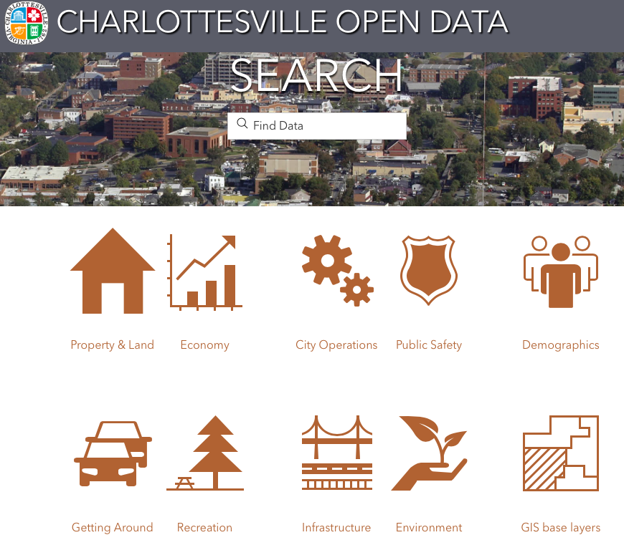
Caitlin Wylie – University of Virginia
Present State
Informing
Consulting
Placating

Slide 29
Caitlin Wylie – University of Virginia
Ideal State
Citizen control!

Slide 30
Caitlin Wylie – University of Virginia
Ideal State
Citizen control!
How to get there?

Slide 31
Caitlin Wylie – University of Virginia
Wylie, Neeley, & Ferguson (2019), "Beyond tech literacy," Digital Culture & Society

Slide 32
Informing
Community members are treated as passive recipients of information about decisions that have or will be made
Notes:
While Arnstein acknowledges that informing “citizens of their rights, responsibilities, and options can be the most important first step toward legitimate citizen participation,” she also notes that “too frequently the emphasis is placed on a one-way flow of information—from officials to citizens—with no channel provided for feedback and no power for negotiation…meetings can also be turned into vehicles for one-way communication by the simple device of providing superficial information, discouraging questions, or giving irrelevant answers.” In informing situations, citizens are “intimidated by futility, legalistic jargon, and prestige of the official” to accept the information provided as fact or endorse the proposals put forward by those in power.

Slide 33
Consultation
Community members are informed of decisions, but they don't actually contribute to them in anyways that aren't simply performative in nature.
Notes:
Similarly, Arnstein notes that “inviting citizens’ opinions, like informing them, can be a legitimate step toward their full participation.” However, when consultation processes “not combined with other modes of participation, this rung of the ladder is still a sham since it offers no assurance that citizen concerns and ideas will be taken into account. The most frequent methods used for consulting people are attitude surveys, neighborhood meetings, and public hearings. When power holders restrict the input of citizens’ ideas solely to this level, participation remains just a window-dressing ritual. People are primarily perceived as statistical abstractions, and participation is measured by how many come to meetings, take brochures home, or answer a questionnaire. What citizens achieve in all this activity is that they have ‘participated in participation.’ And what powerholders achieve is the evidence that they have gone through the required motions of involving ‘those people.’”

Slide 34
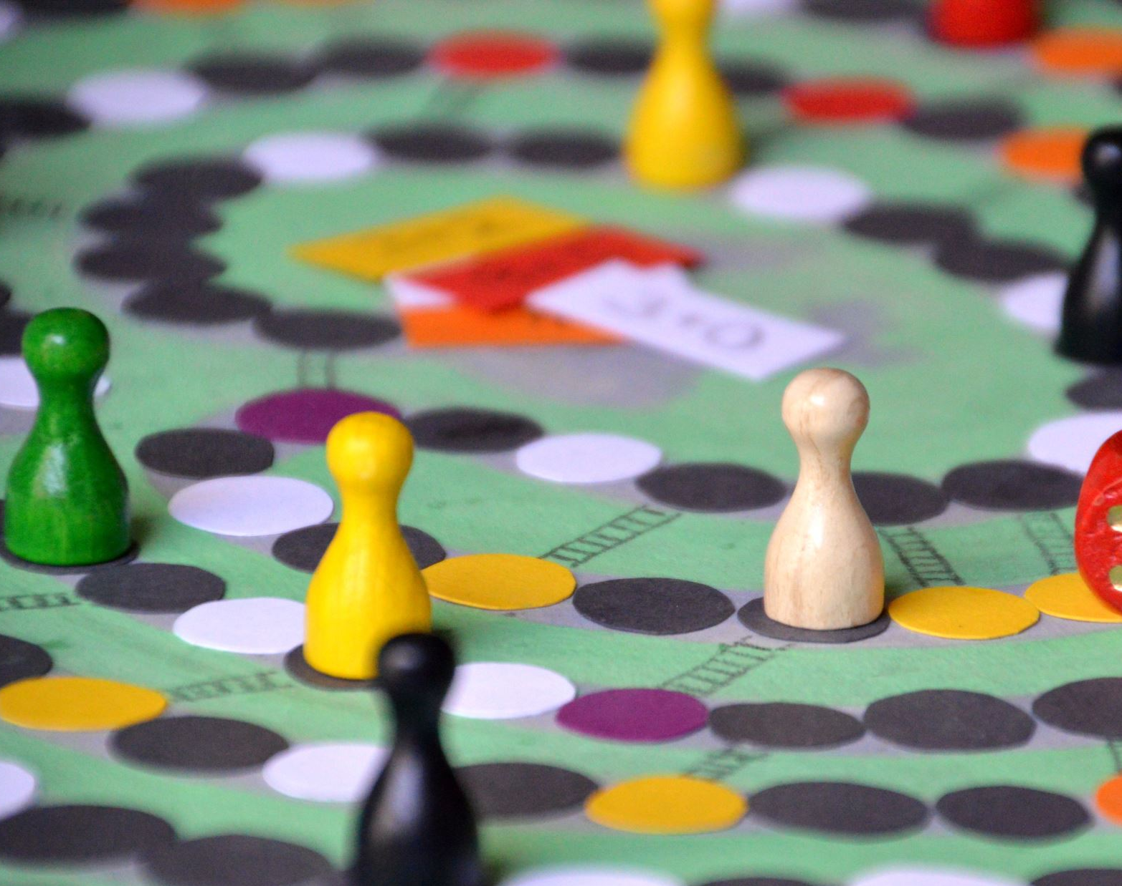
Placation
While community members may shape ideas, final decision-making power does not belong to them. Problems with this often arise with concerns to attribution and or complete disregard of some areas of sects of the community.
Notes:
Participation as placation occurs when citizens are granted a limited degree of influence in a process, but their participation is largely or entirely tokenistic: citizens are merely involved only to demonstrate that they were involved. In Arnstein’s words: “An example of placation strategy is to place a few hand-picked ‘worthy’ poor on boards of Community Action Agencies or on public bodies like the board of education, police commission, or housing authority. If they are not accountable to a constituency in the community and if the traditional power elite hold the majority of seats, the have-nots can be easily outvoted and outfoxed.”

Slide 35
Examples
Mingle – 30 seconds
Pair – 2 minutes
Share
What are some examples of tokenism that you have seen, heard about, or thought about in the field?

Slide 36
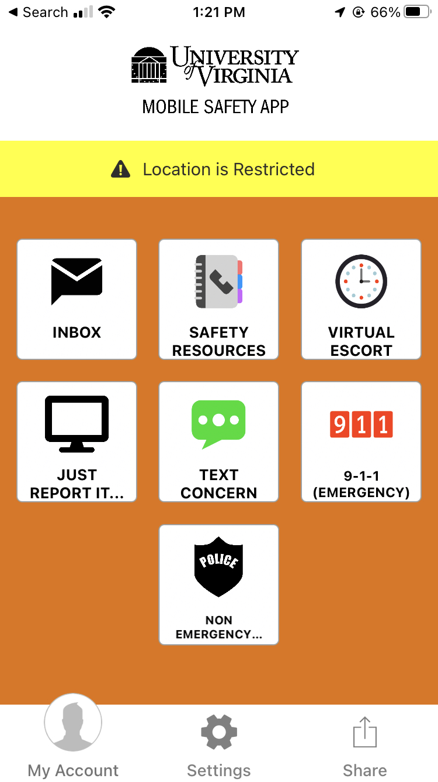
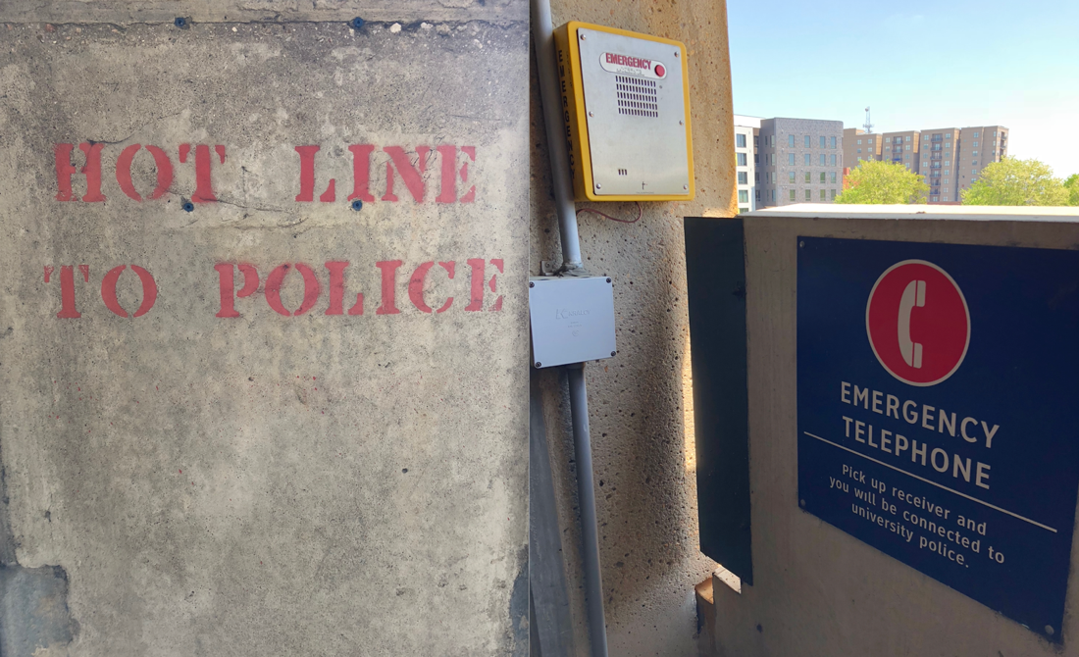
Elizabeth Ellcessor – University of Virginia
Reconsidering Technologies of Campus Safety
Present State: Consultation Partnership Delegated Power

Slide 37
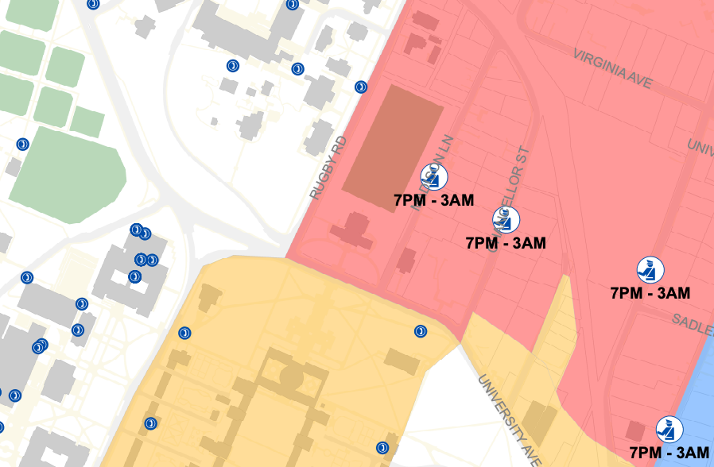
Elizabeth Ellcessor – University of Virginia
Reconsidering Technologies of Campus Safety
Ideal State: Partnership Delegated Power

Slide 38
Partnership
Community members operate as stakeholders with direct-decision making power. This power is authentic and iterative.
Notes:
Participation as partnership occurs when public institutions, officials, or administrators allow citizens to negotiate better deals, veto decisions, share funding, or put forward requests that are at least partially fulfilled. In Arnstein’s words: “At this rung of the ladder, power is in fact redistributed through negotiation between citizens and powerholders. They agree to share planning and decision-making responsibilities through such structures as joint policy boards, planning committees, and mechanisms for resolving impasses. After the groundrules have been established through some form of give-and-take, they are not subject to unilateral change.” Arnstein does note, however, that in many partnership situations, power is not voluntarily shared by public institutions, but rather taken by the citizens through actions such as protests, campaigns, or community organizing.

Slide 39
Delegated Power
While the goal/s don't come from the community, the resources AND responsibility is delegated to community member.
Notes:
Participation as delegated power occurs when public institutions, officials, or administrators give up at least some degree of control, management, decision-making authority, or funding to citizens. For example, a citizen board or corporation that is tasked with managing a community program, rather than merely participating in a program managed by a city, would be an example of delegated power. In Arnstein’s words: “At this level, the ladder has been scaled to the point where citizens hold the significant cards to assure accountability of the program to them. To resolve differences, powerholders need to start the bargaining process rather than respond to pressure from the other end.”

Slide 40
Citizen Control
Community members generate the ideas and goals and then lead and evaluate efforts. Researchers and others often find that they don't necessarily see where they fit at this level.
Notes:
Participation as citizen control occurs, in Arnstein’s words, when “participants or residents can govern a program or an institution, be in full charge of policy and managerial aspects, and be able to negotiate the conditions under which ‘outsiders’ may change them.” In citizen-control situations, for example, public funding would flow directly to a community organization, and that organization would have full control over how that funding is allocated.

Slide 41
So, what is best?
One might think that Citizen Control is best in all situations, but that is not always the case.
Notes:
Sometimes citizens, especially those who are most marginalized do not want the pressure that comes with full control.
Sometimes control is turned over to citizens without the structures to succeed to watch them fail.

Slide 42
What about things that don't fit on the ladder?
Notes:
While the ladder metaphor is useful to think about when one considers community engaged research, there is work that doesn't fit on the ladder, but does serve to assist community members and researchers in moving from present to ideal state.

Slide 43
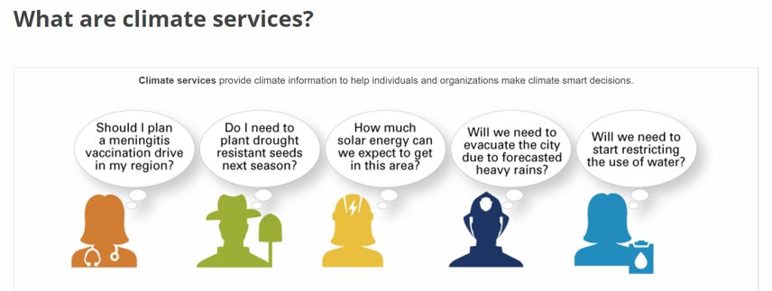
Wendy Parker – Virginia Tech
Present State: Informing

Slide 44
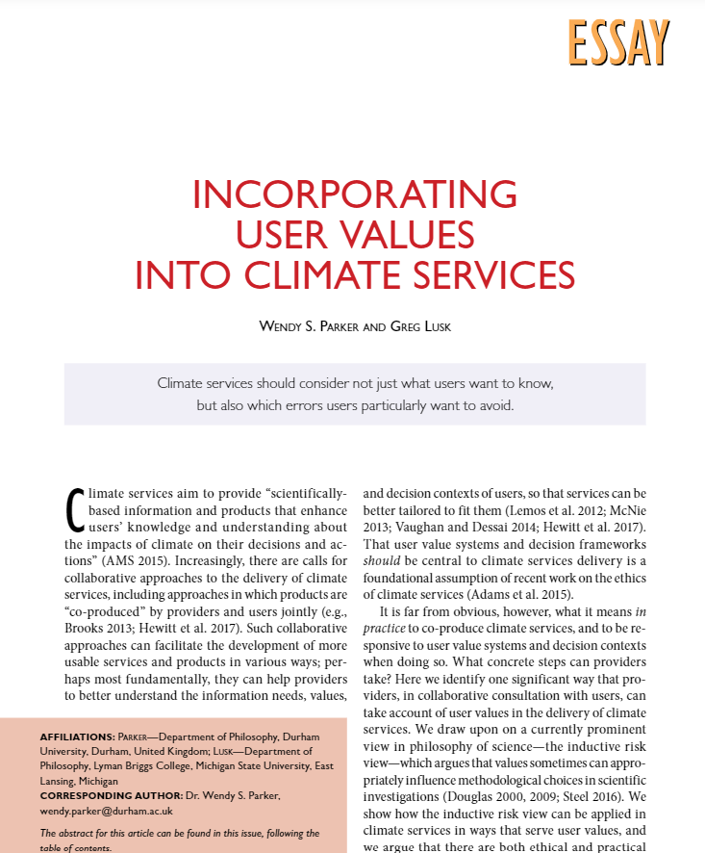
Wendy Parker – Virginia Tech
Ideal State: Partnership
How to get there?
My contribution focuses on how detailed scientific choices could be made differently, responsive to citizen/user aims and values.

Slide 45
Remember the Why!
Sherry R. Arnstein, “A Ladder of Citizen Participation,” Journal of the American Planning Association
Notes:
As we come to a close, I want you to circle back and remember the why. Remember the idea of eating broccoli, and the thought that it would probably be good for everyone. We need to align out mission, visions, and values with this work or connect with those who are in alignment.
“The idea of citizen participation is a little like eating spinach: no one is against it in principle because it is good for you. Participation of the governed in their government is, in theory, the cornerstone of democracy—a revered idea that is vigorously applauded by virtually everyone. The applause is reduced to polite handclaps, however, when this principle is advocated by the have-not (Black People), Mexican-Americans, Puerto Ricans, (Native Americans), (Inuit People), and whites. And when the have-nots define participation as redistribution of power, the American consensus on the fundamental principle explodes into many shades of outright racial, ethnic, ideological, and political opposition.”

Slide 46
Think about your work. Where is it now? Where would you like it to be? How will you get there?
Notes:
I want to leave you with these parting questions:
Where is it now? Where would you like it to be? How will you get there?

Slide 47
More questions to keep the conversation flowing...
How might you begin a community-engaged research project?
What challenges do you anticipate in community-engaged research?
Notes:
Continue the conversation externally as well..

Slide 48
Close: Keep the Conversation Going
Notes:
You can learn more about The Equity Center and our work by visiting, virginiaequitycenter.org
And more about the ladder of citizen participation by visiting organizingengagement.org
Thank you!

